Slide 1
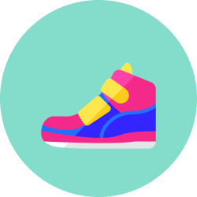
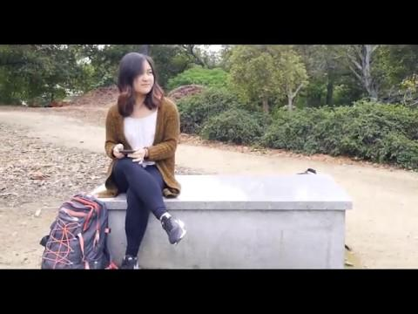

Slide 2
DÉRIVÉ
SHOES YOUR OWN ADVENTURE
Notes:
Hi everyone, we’re Derive. I’m Meena…. This is… and where is Annalise?

Slide 3
Our Motivation
We’re so focused on getting from A to B that we forget to appreciate the journey.
Address the problem of being disconnected from the environment.
Encourage people to be present, rather than on their phones
Empower people to explore on their own or share their adventure with others.
Inspire spontaneous discovery and detours
Notes:
When was the last time you discovered something new by chance? How about, the last time you went somewhere without consulting your phone? We couldn’t remember either and that’s why we created Derive. We’re so focused on getting from point A to point B, that we forget to appreciate the journey and immerse ourselves in our own environments. We were motivated to connect our users back to their environment, encourage them to explore, and to inspire a sense of adventure.

Slide 4
How might we introduce a sense of adventure through human-powered transportation?
Notes:
Before we could address our motivation, we had to ask: How might we introduce a sense of adventure through human-powered transportation?

Slide 5
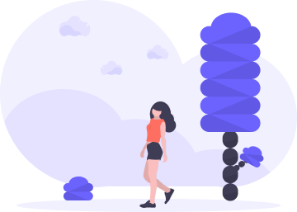
Our Target User
Young adults whose primary mode of transportation is walking.
User Goals: Use their phones less during leisure activities and explore their environments without a precursory intent.
Notes:
First, we found our user: young adults whose primary modes of transportation are walking. When people are walking, they have so many opportunities to bask in their environment, engage with passersby, or take little detours. Our goal was to reduce time spent on phones and allow these individuals to explore their environment without a precursor to their intent.

Slide 6
Dérivé is a dynamic mode of discovery that lights the path to an adventure.
Notes:
By switching off predictability and turning on a chance for spontaneity, we empower people to choose their own adventure.

Slide 7

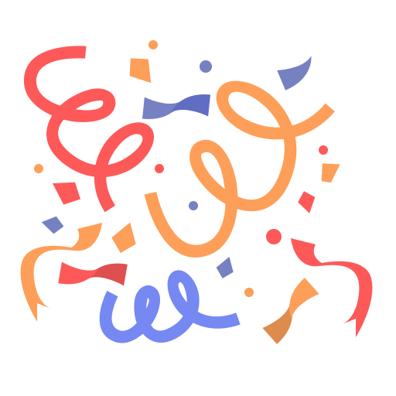
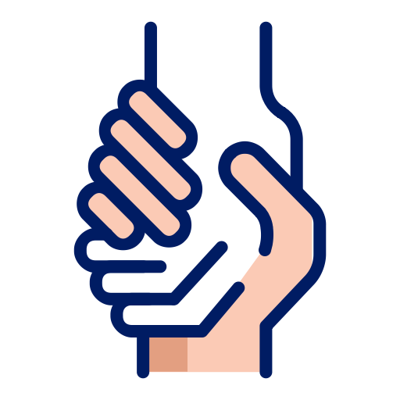
Design Objectives
Inspire adventure
Create fun
Facilitate connection
Notes:
When we created the interactions for Derive, we had to keep in mind our original motivations: appreciate the journey and connect w the environment… Our design objectives:
Inspire a sense of adventure, encourage people to explore their environments
Introduce/Reintroduce fun into everyday routines
Facilitate connection between people by sharing journeys and between people and their environments

Slide 8
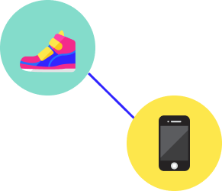
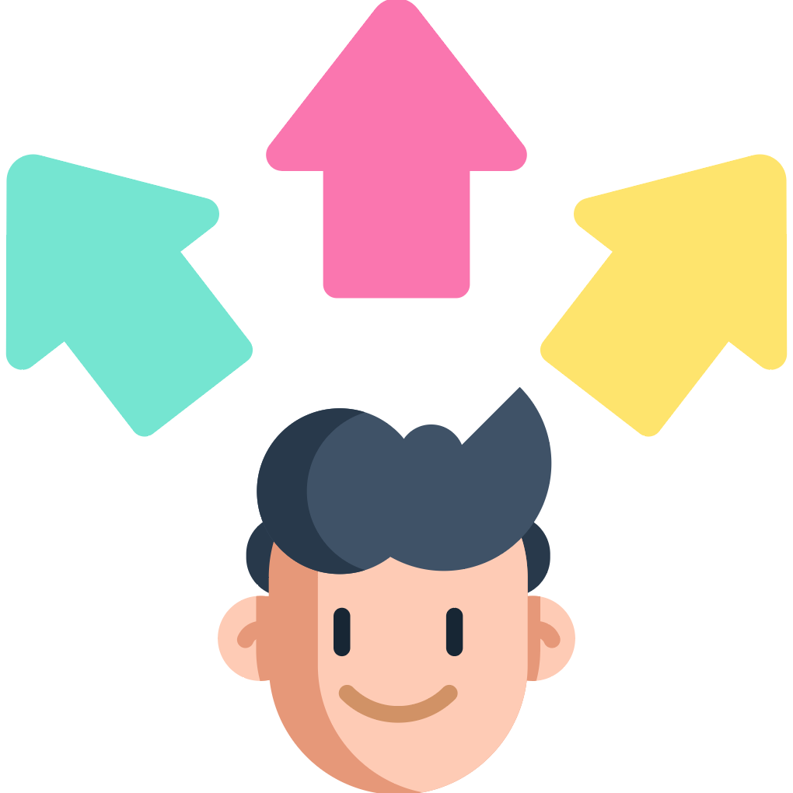

How It Works
Dérivé connects to your phone and allows you to choose desired adventure preferences.
Dérivé takes you on flexible paths that fit your preferences, instead of navigating you to fixed locations.
Dérivé provides directions whenever you stop and look at your shoes, allowing you to focus on the environment.
Notes:
Derive connects to your phone and allows you to choose your preferred distance, duration, and topics.

Slide 9
Features
Hands-free navigation
Dérivé gives directions whenever users stop and pause
Shoes will flash LED lights “right” or “left” to signal turning
Ends when you’ve reached Dérivé’s destination
Reminder to focus on the journey
Activity screen redirects focus to the environment rather than the phone
Reframes the concept of “getting lost”
Introduce moments of delight
To indicate an interesting place, the shoes will glow on all sides

Slide 10
Use Cases
People who recently moved to a new city
Visitors or tourists
Special occasions (e.g., birthday, anniversary, etc.)
People who want to break from their mundane routines
People who want to explore their city

Slide 11


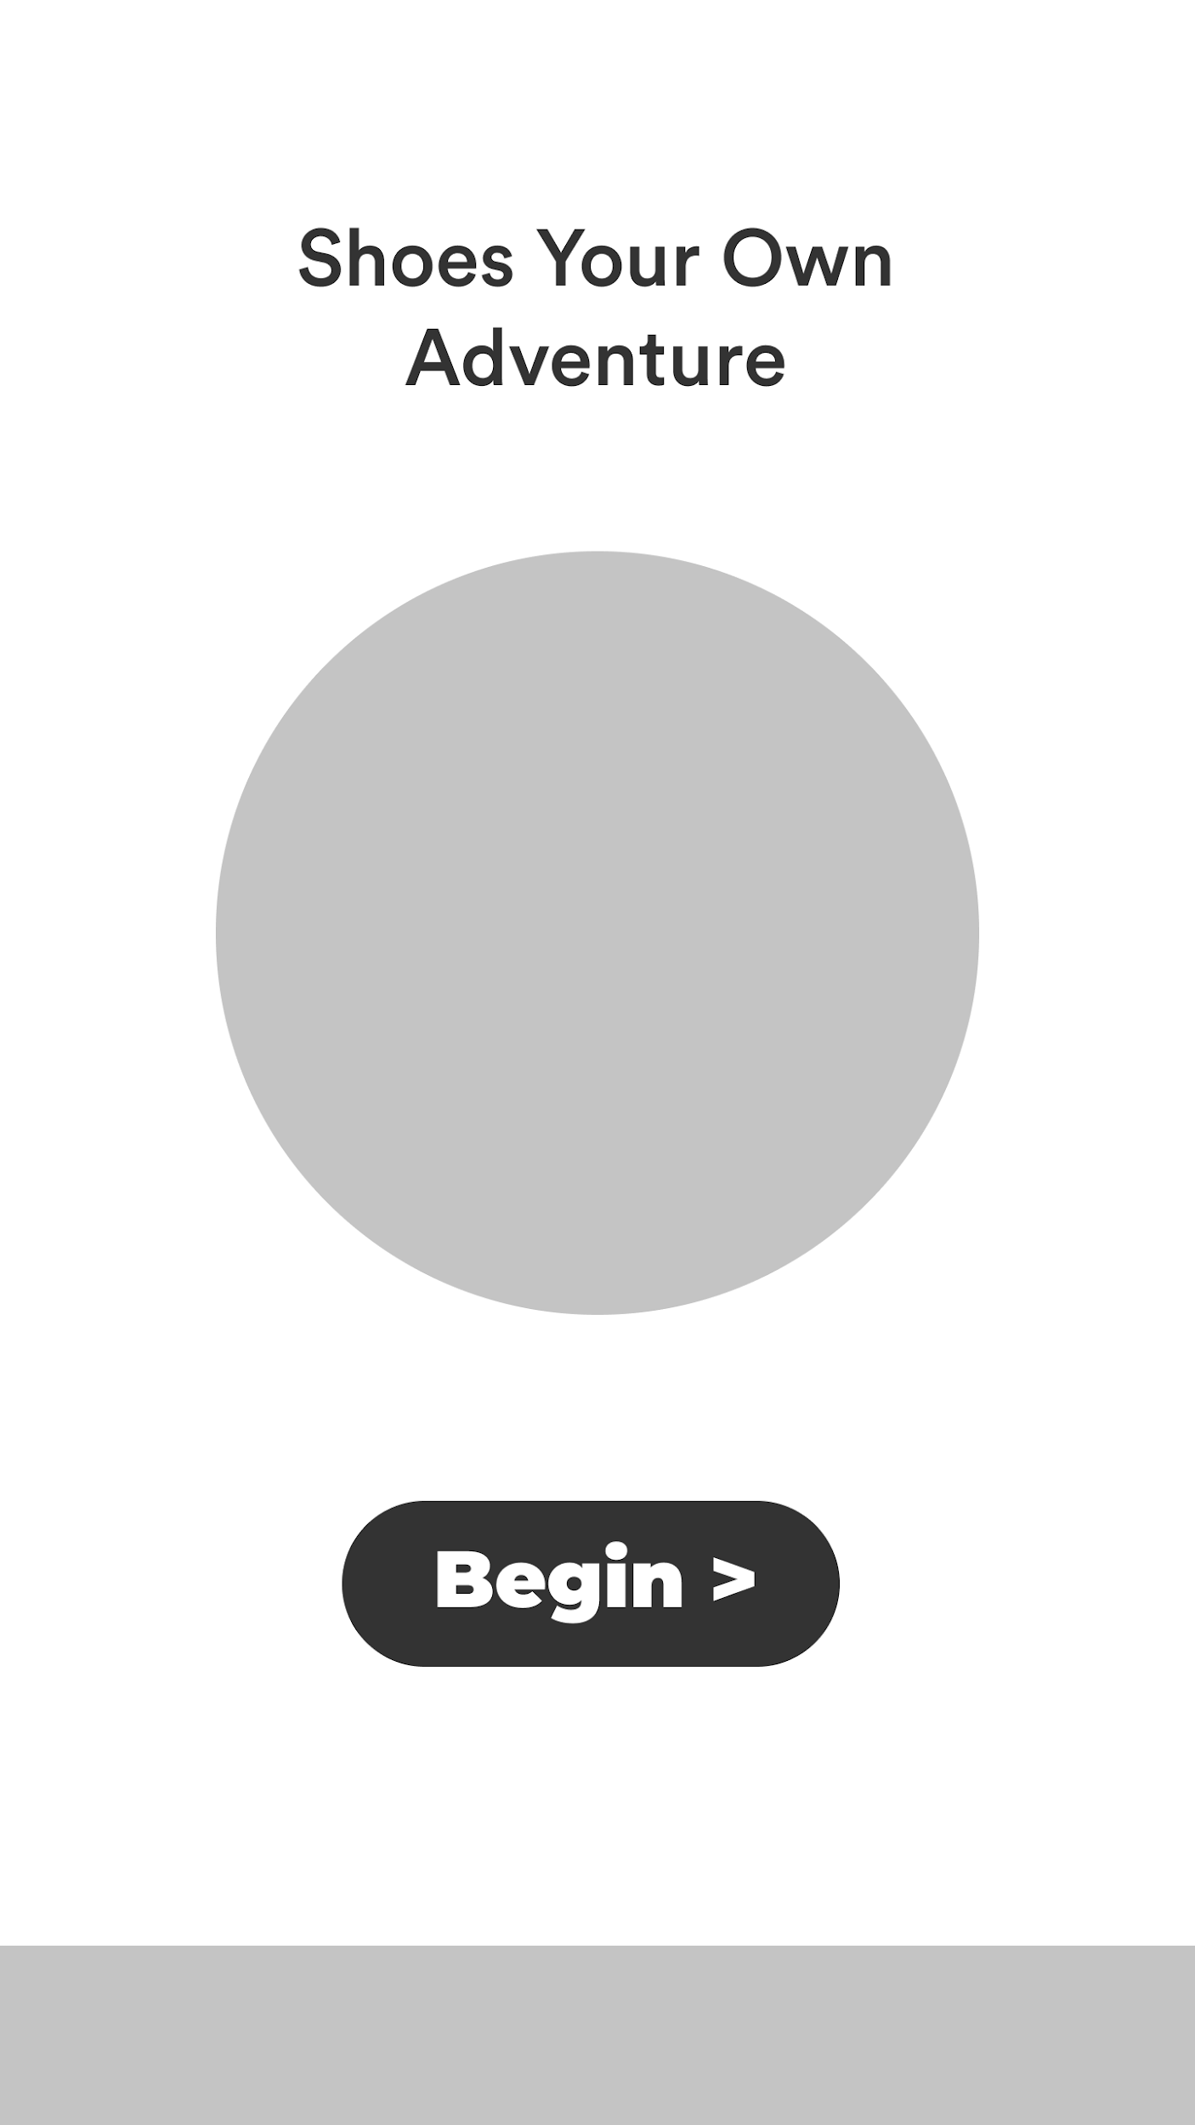
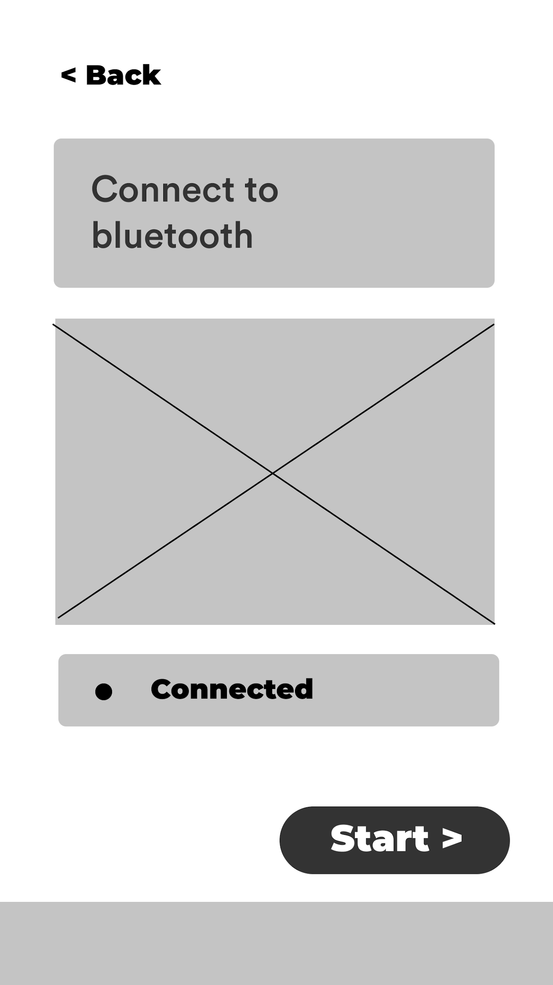
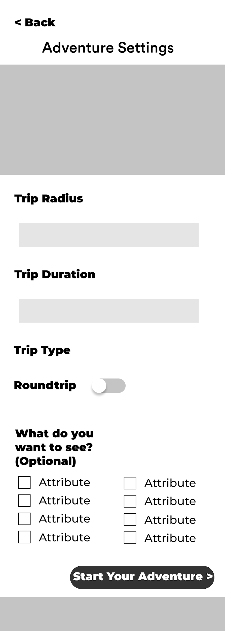
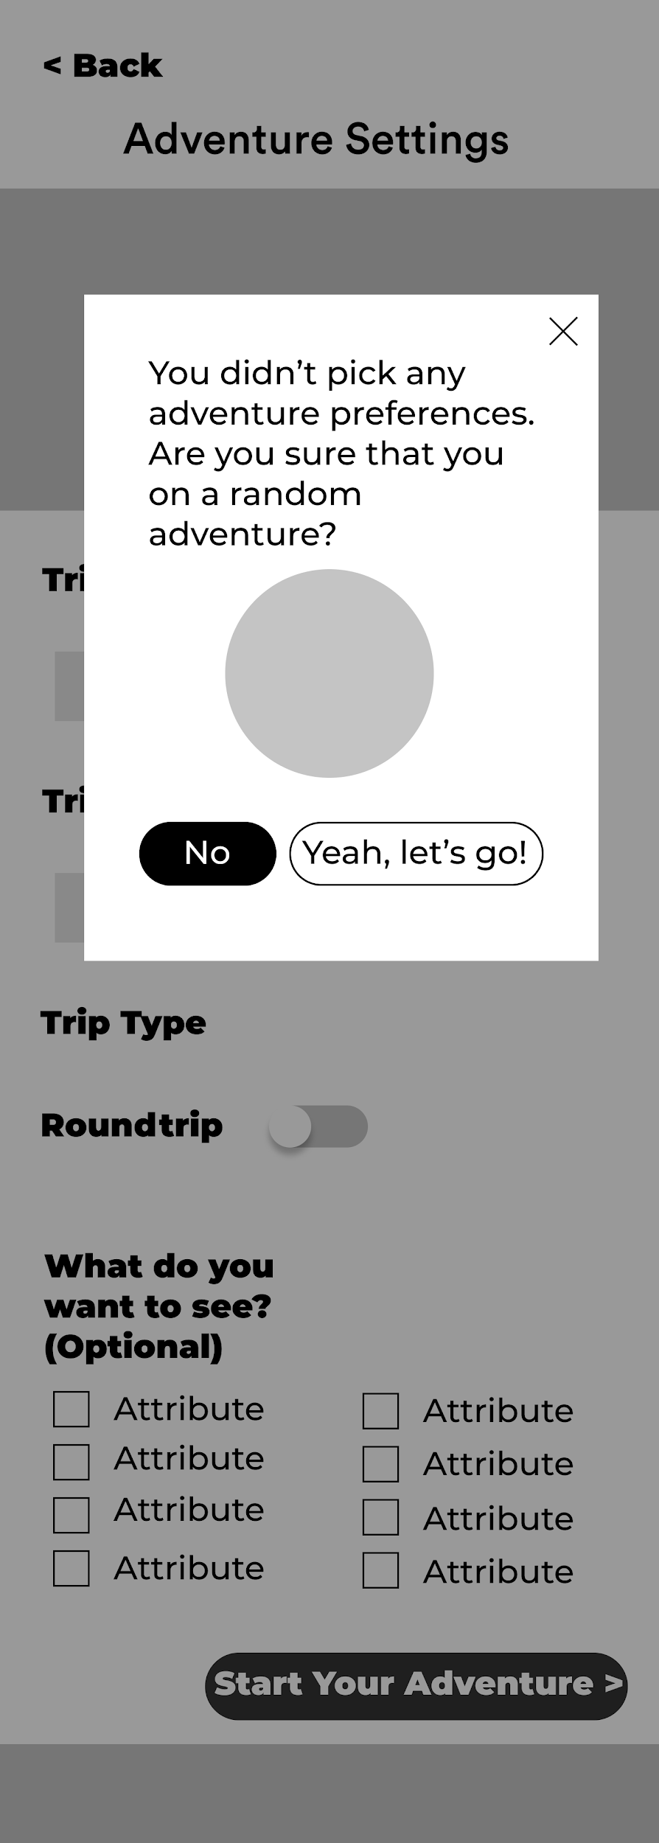
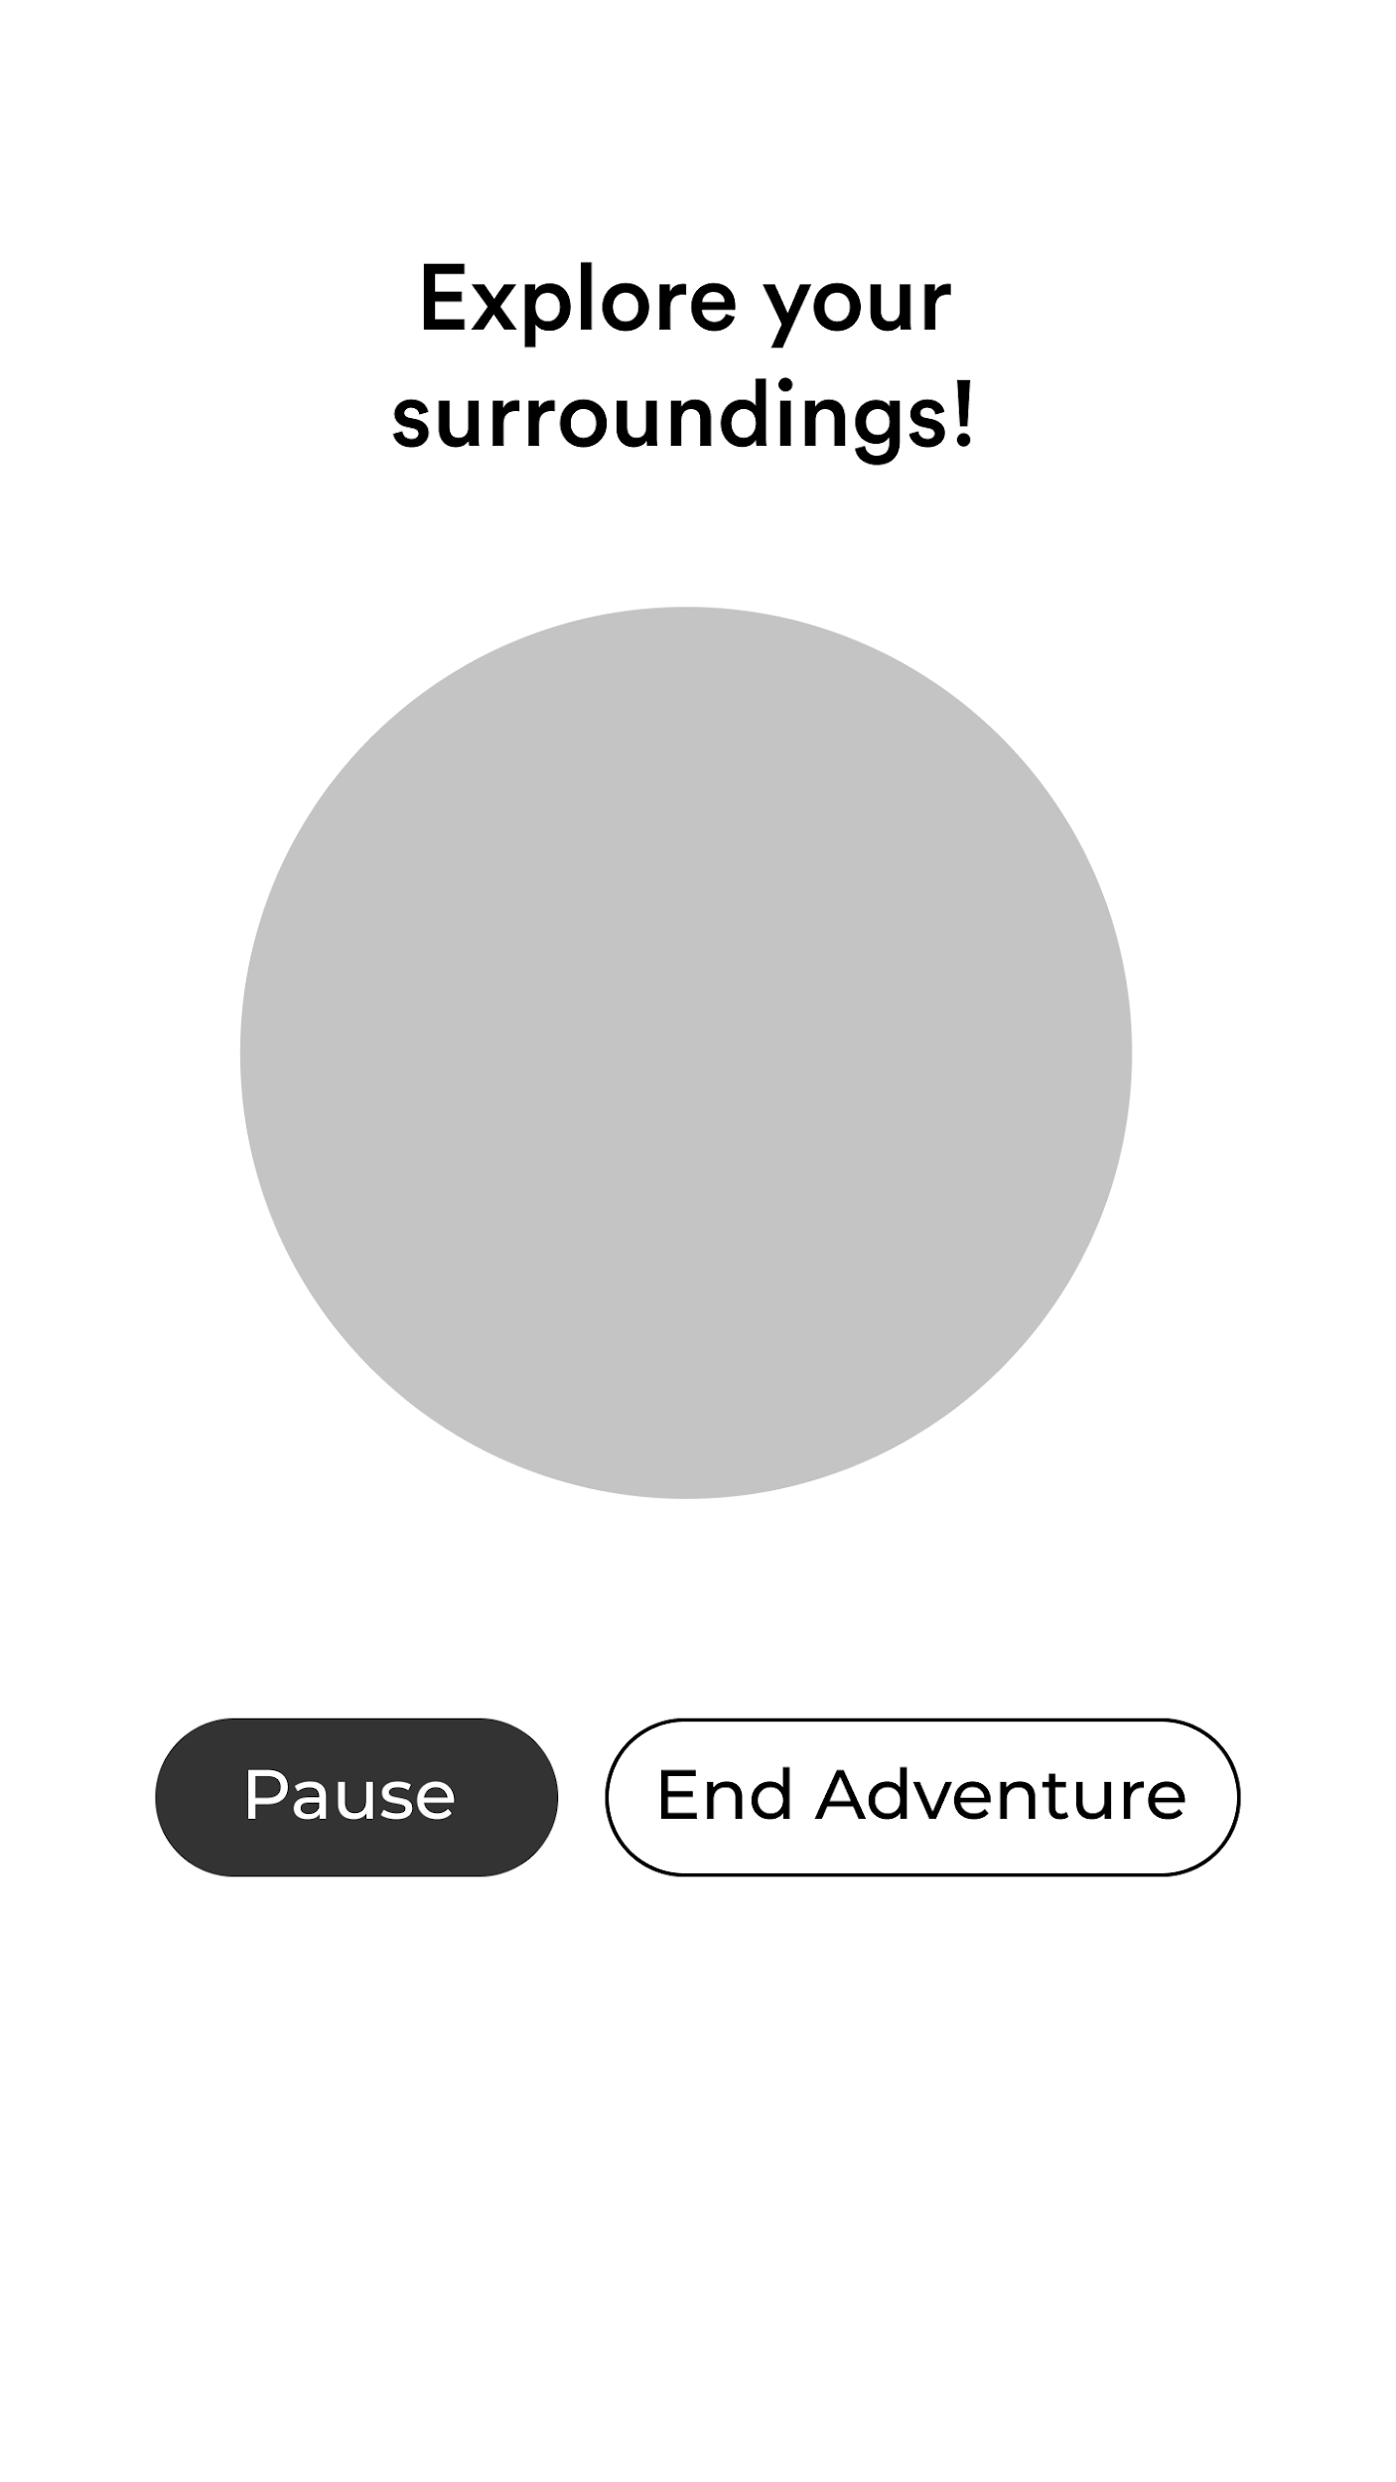
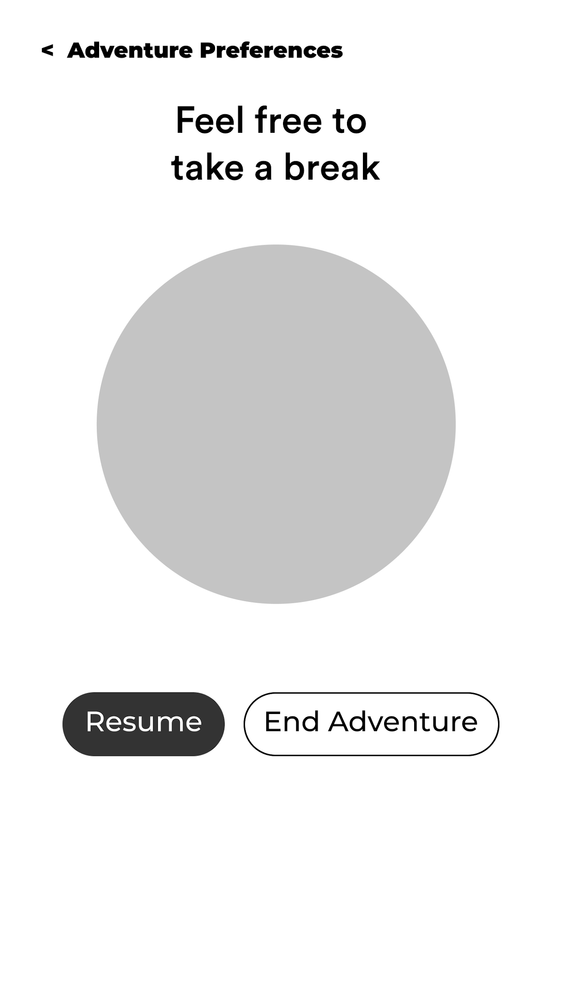
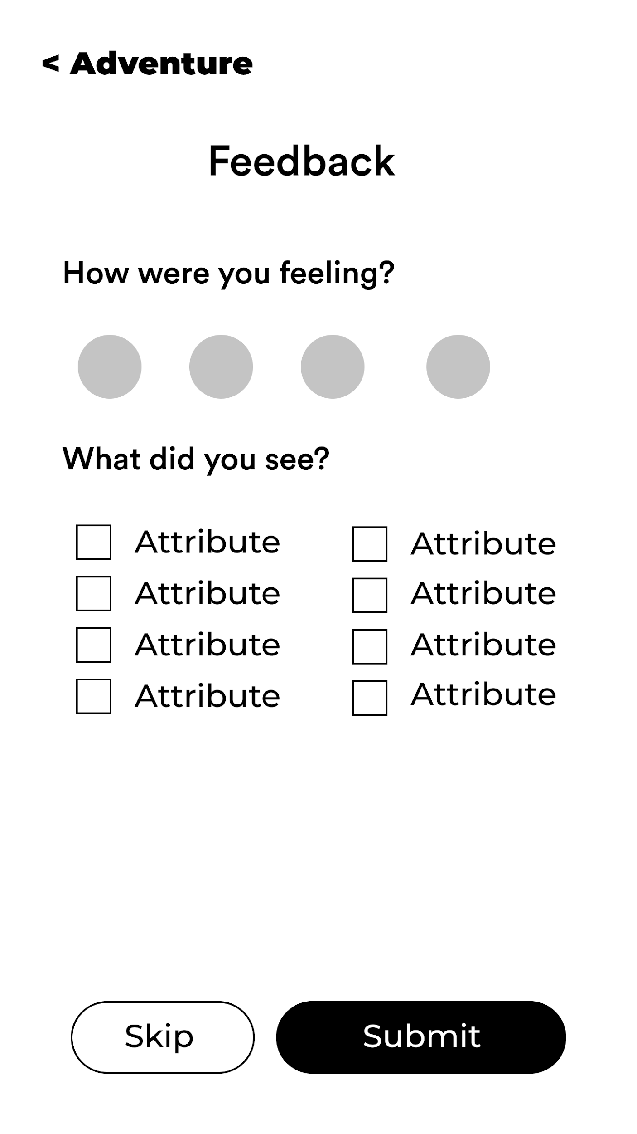
Wireframes
Low-Fidelity Wireframes

Slide 12
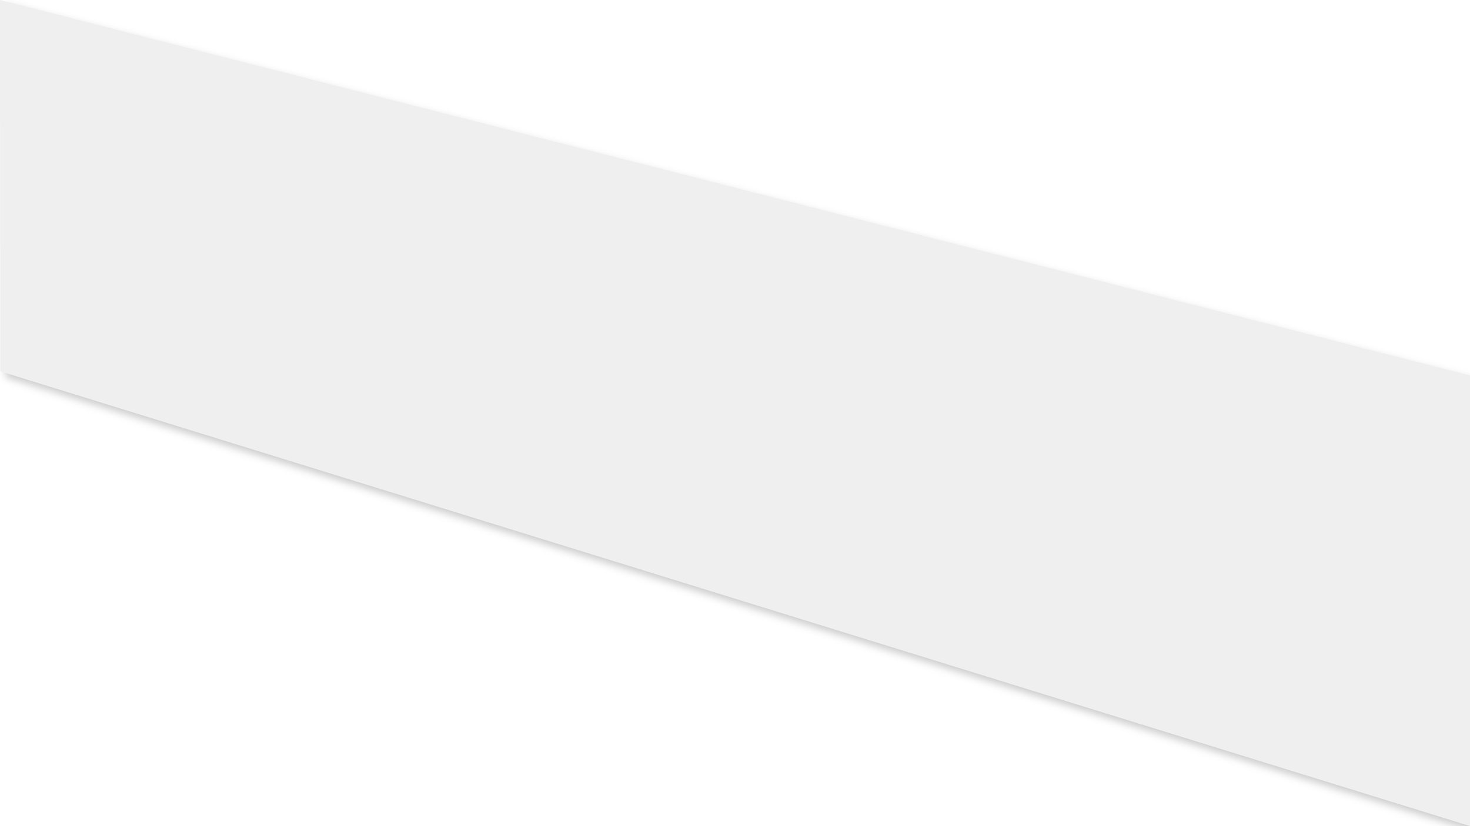
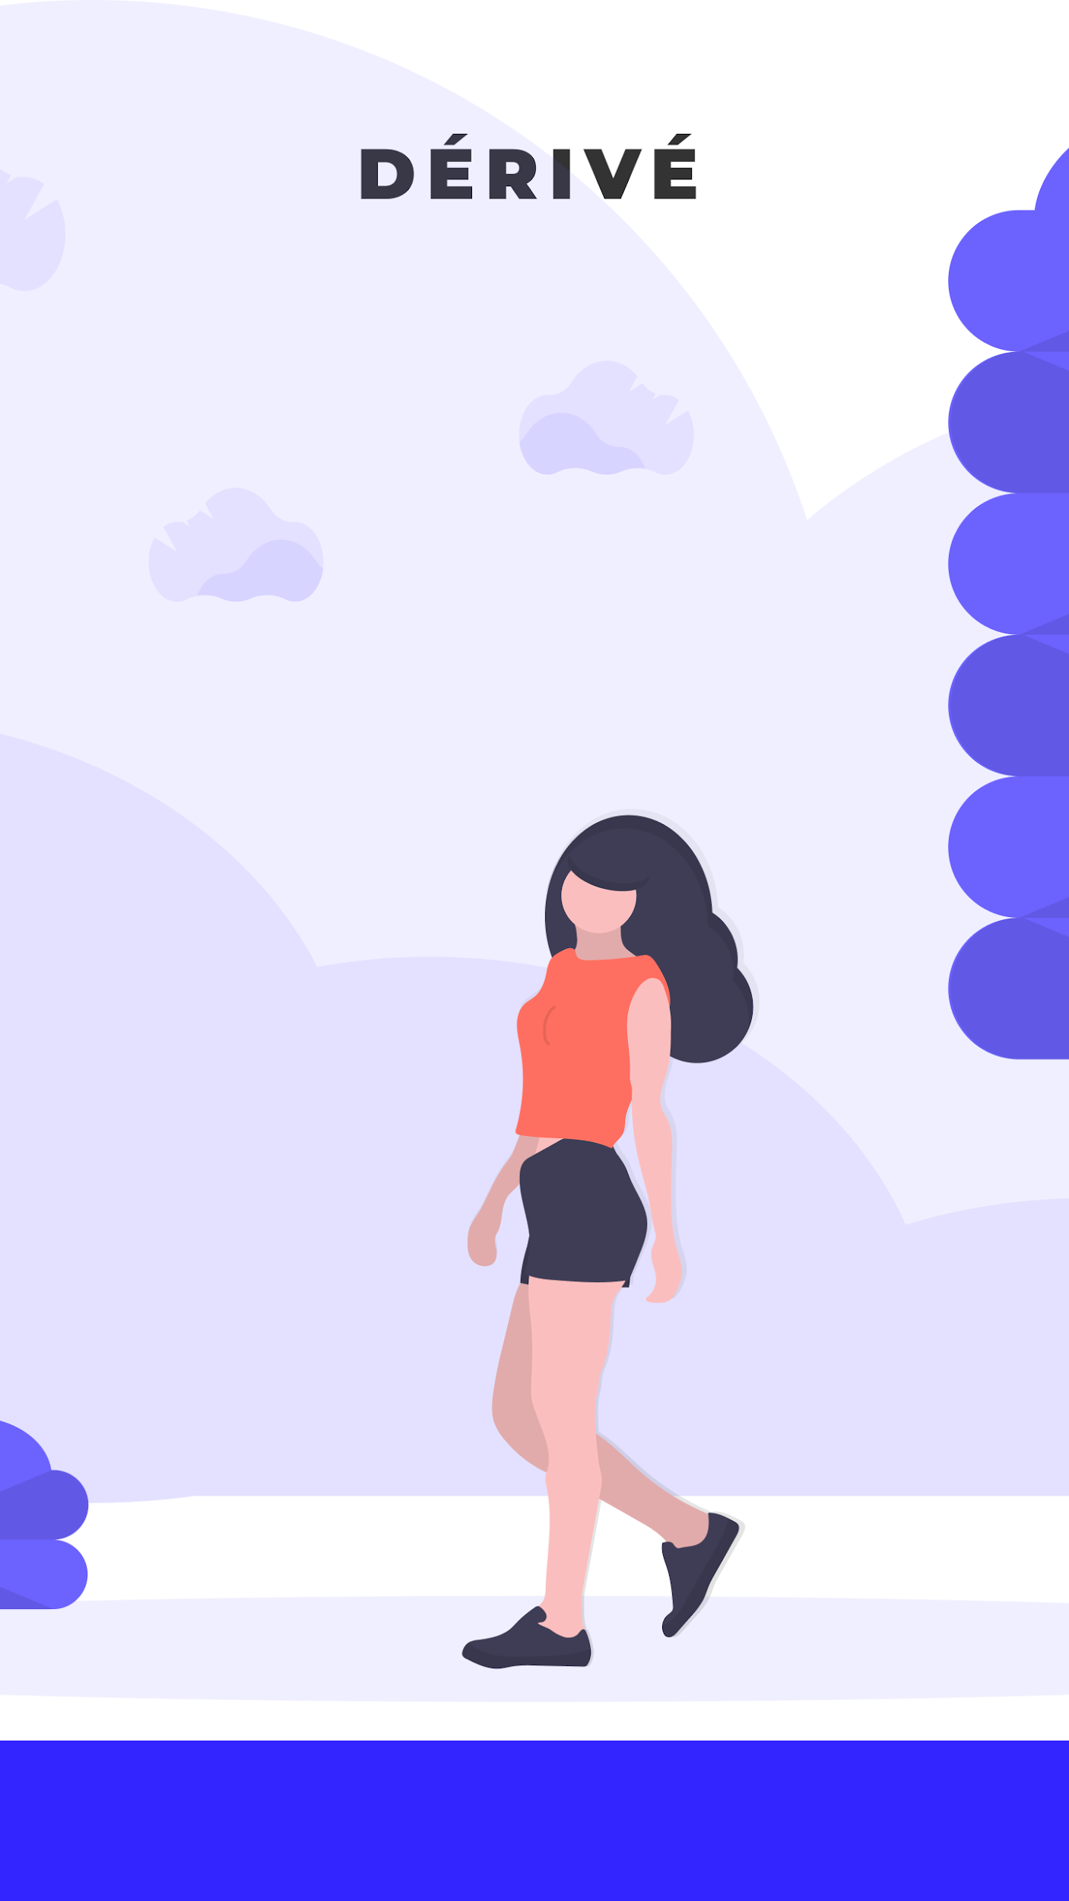
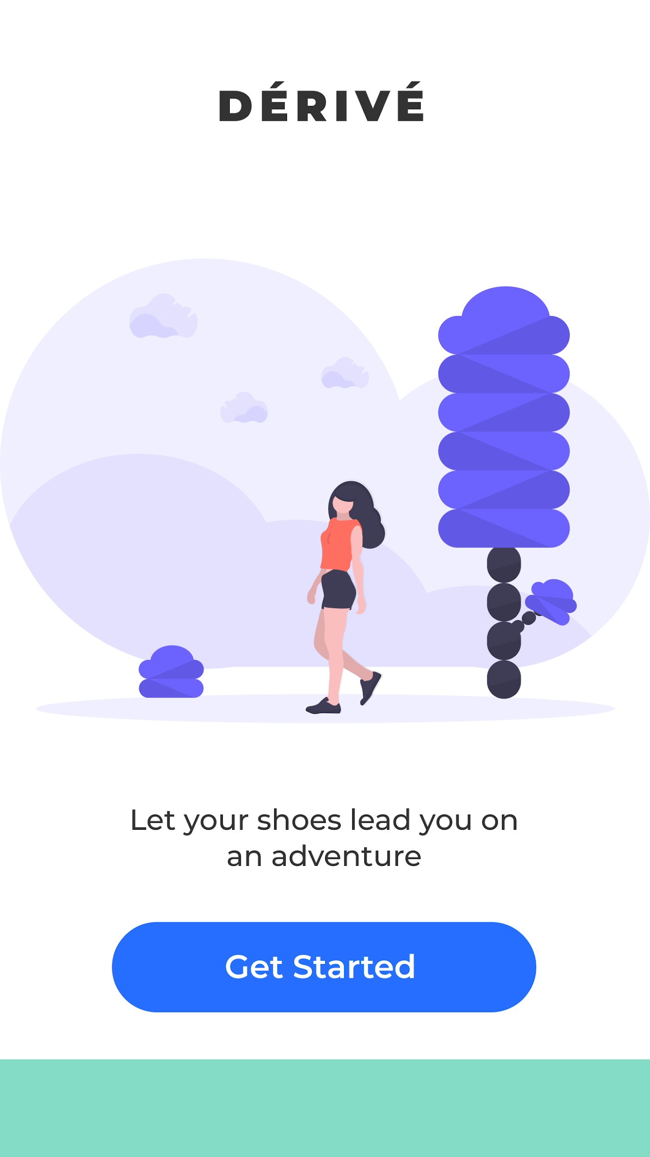
Hi-Fidelity Mockups: Welcome

Slide 13
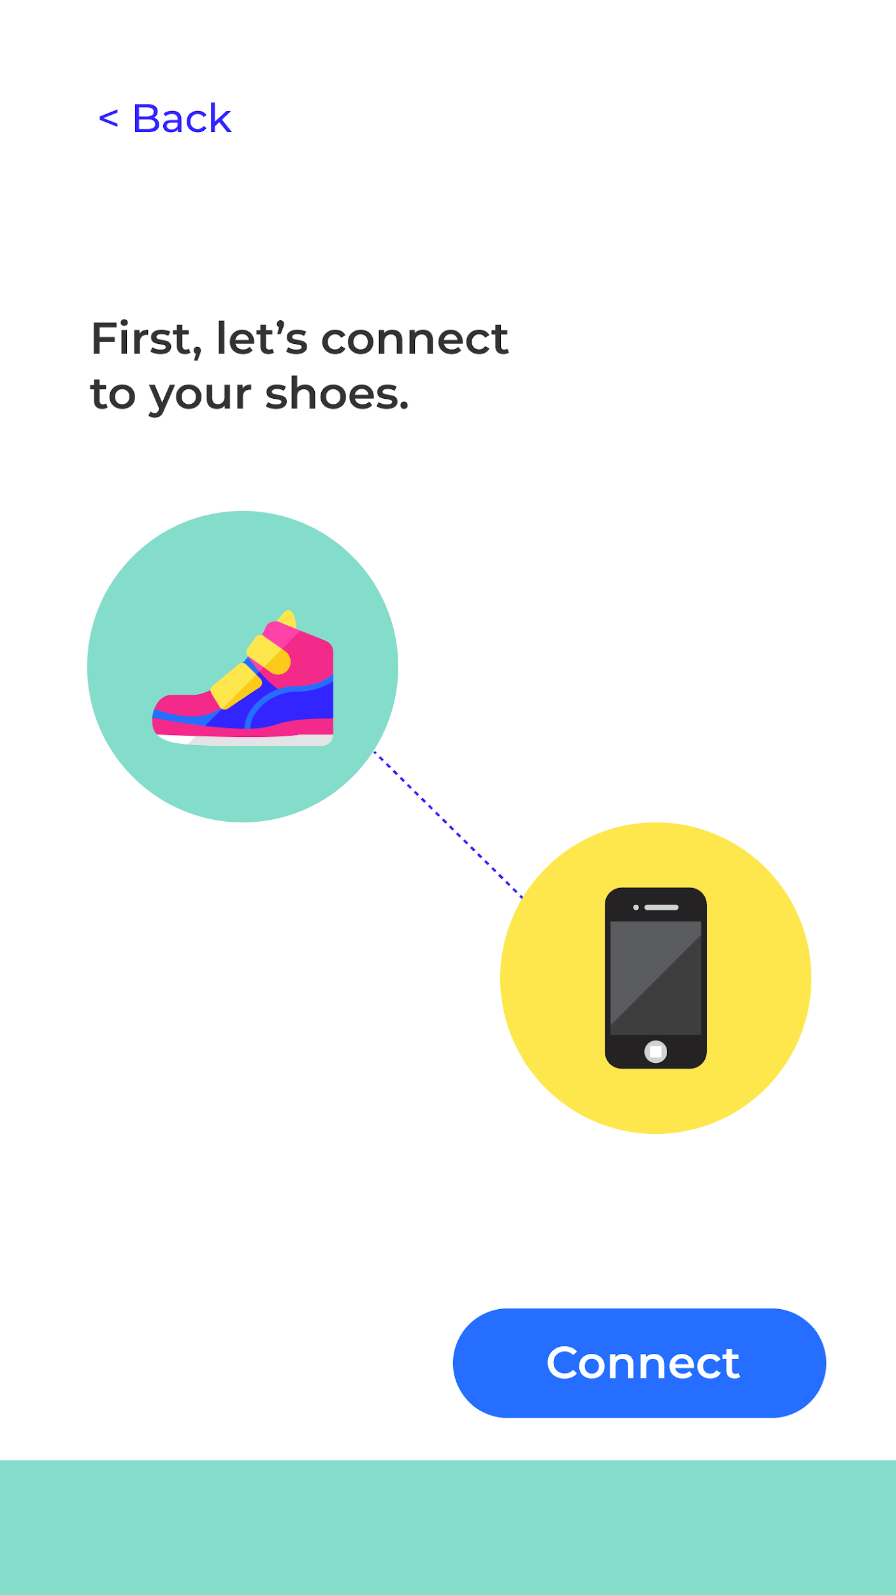
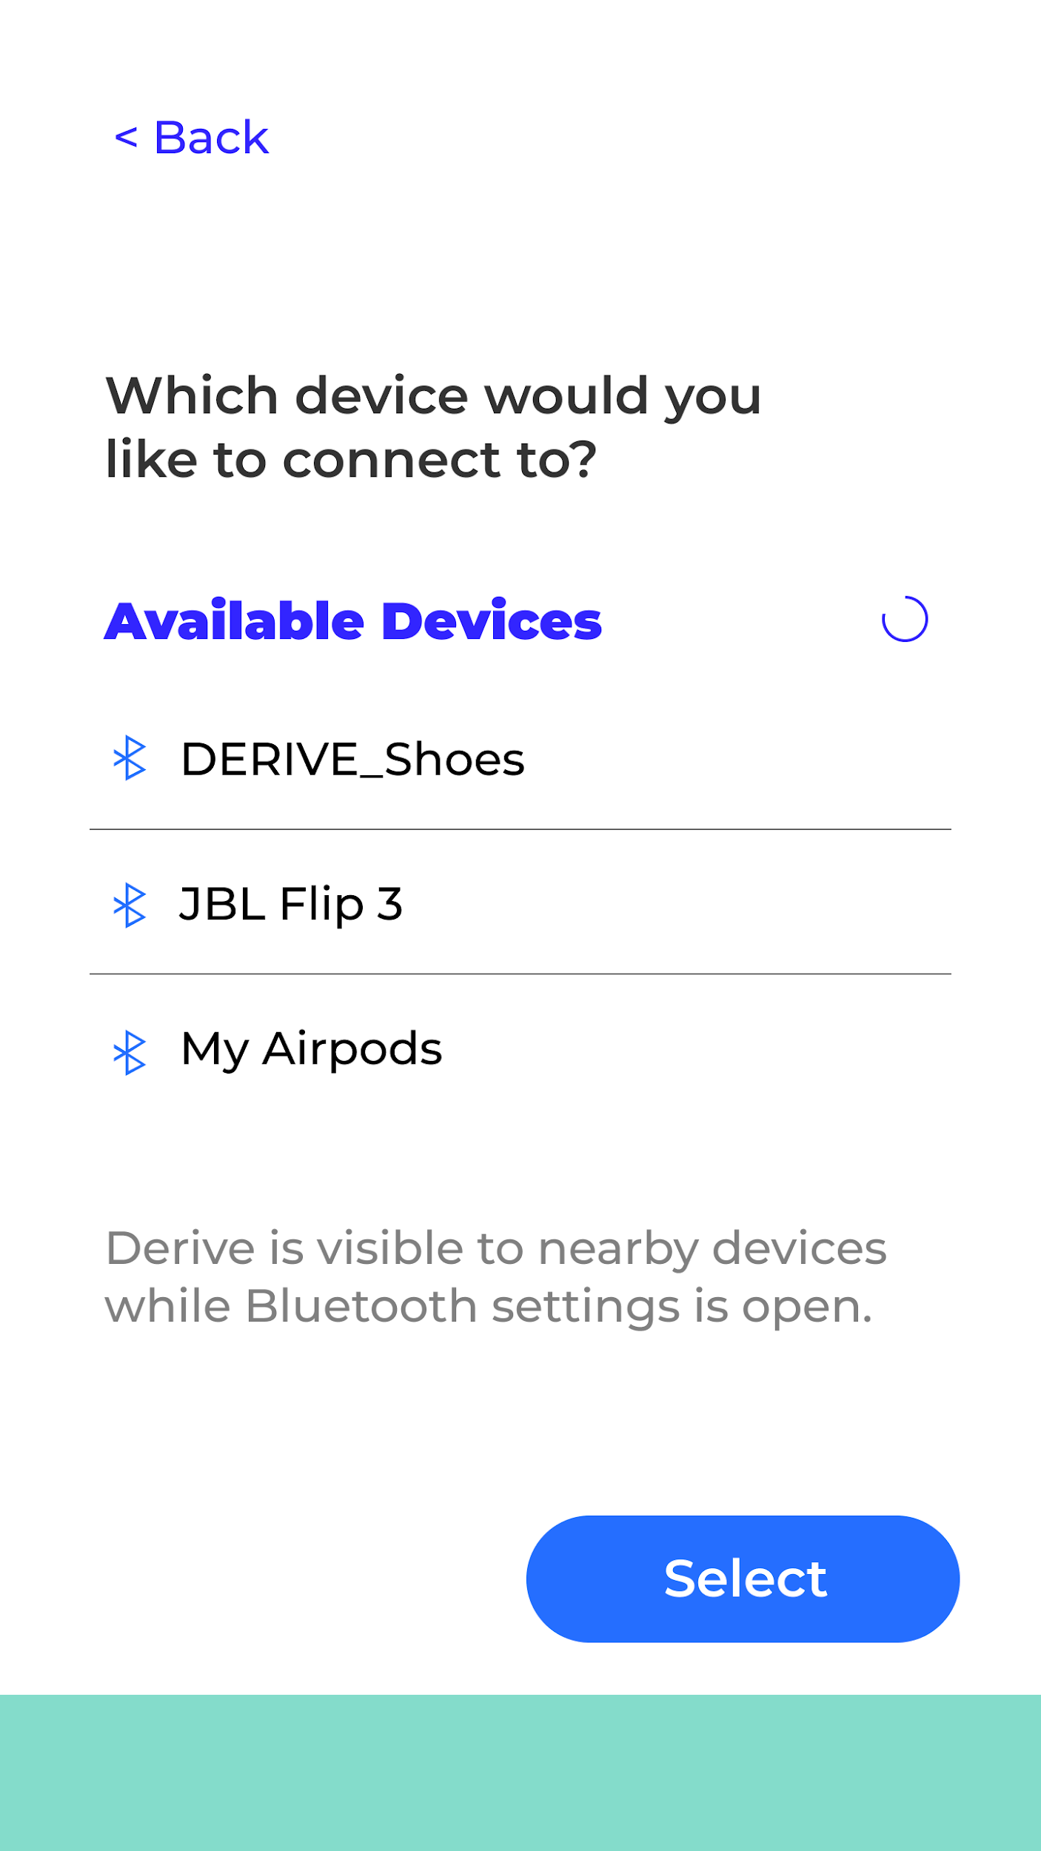
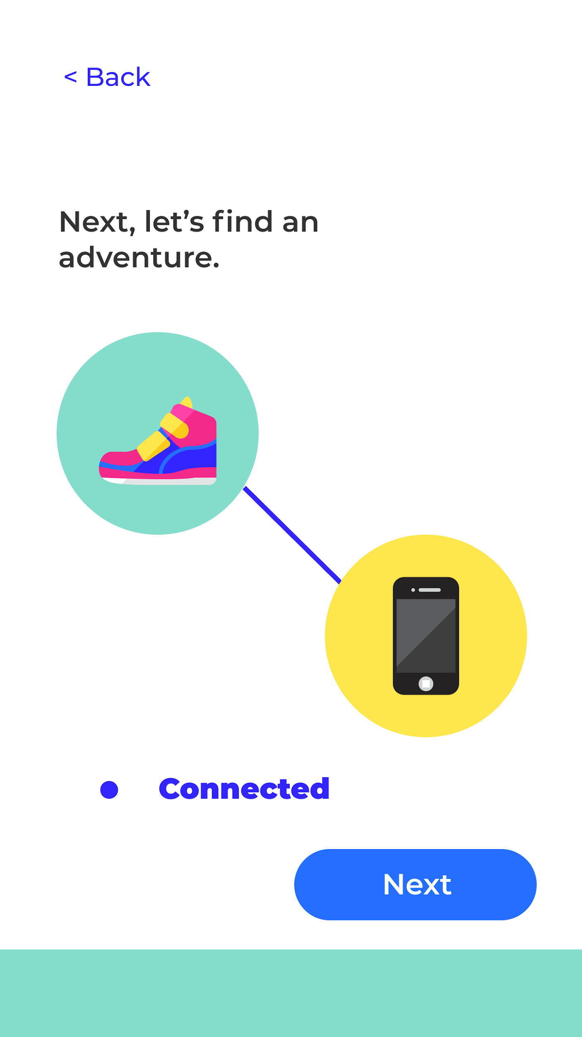
Hi-Fidelity Mockups: Bluetooth Connection
Notes:
Janaki will talk about connectivity

Slide 14
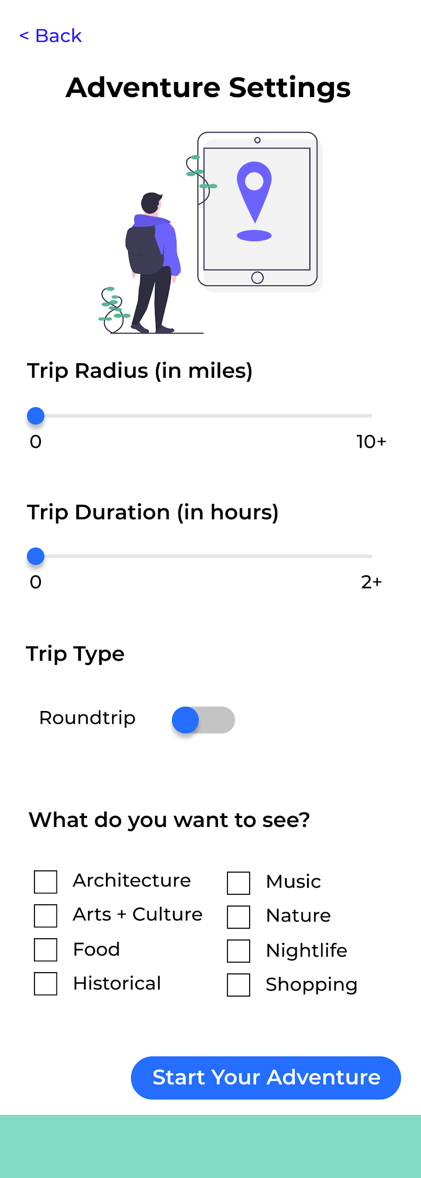
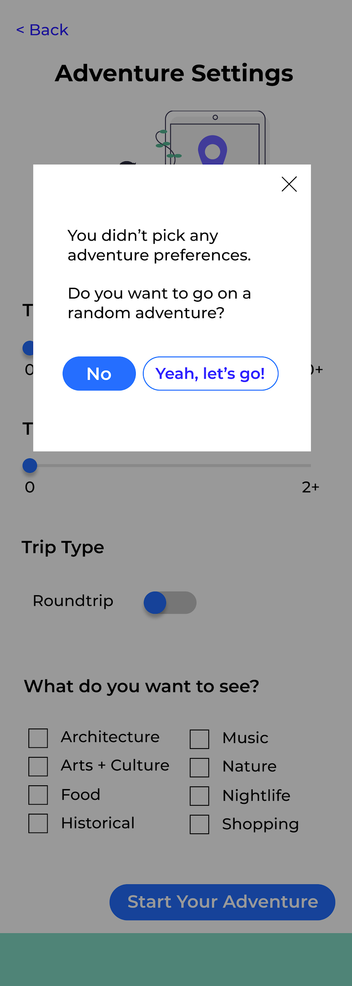
Hi-Fidelity Mockups: Preferences

Slide 15
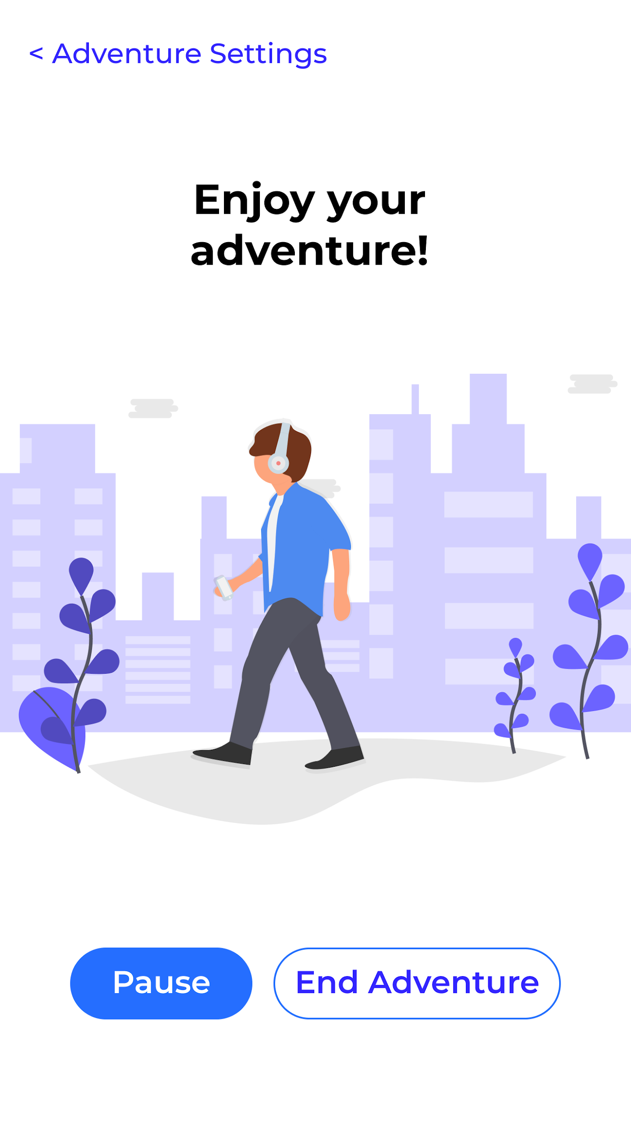
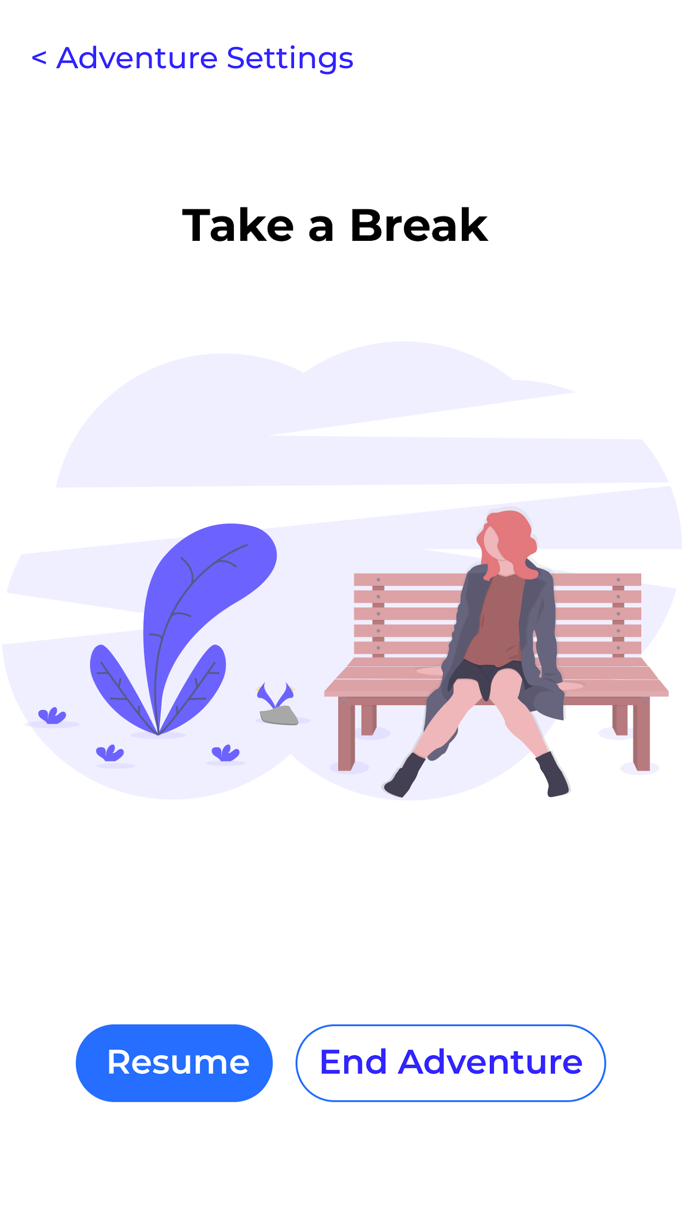
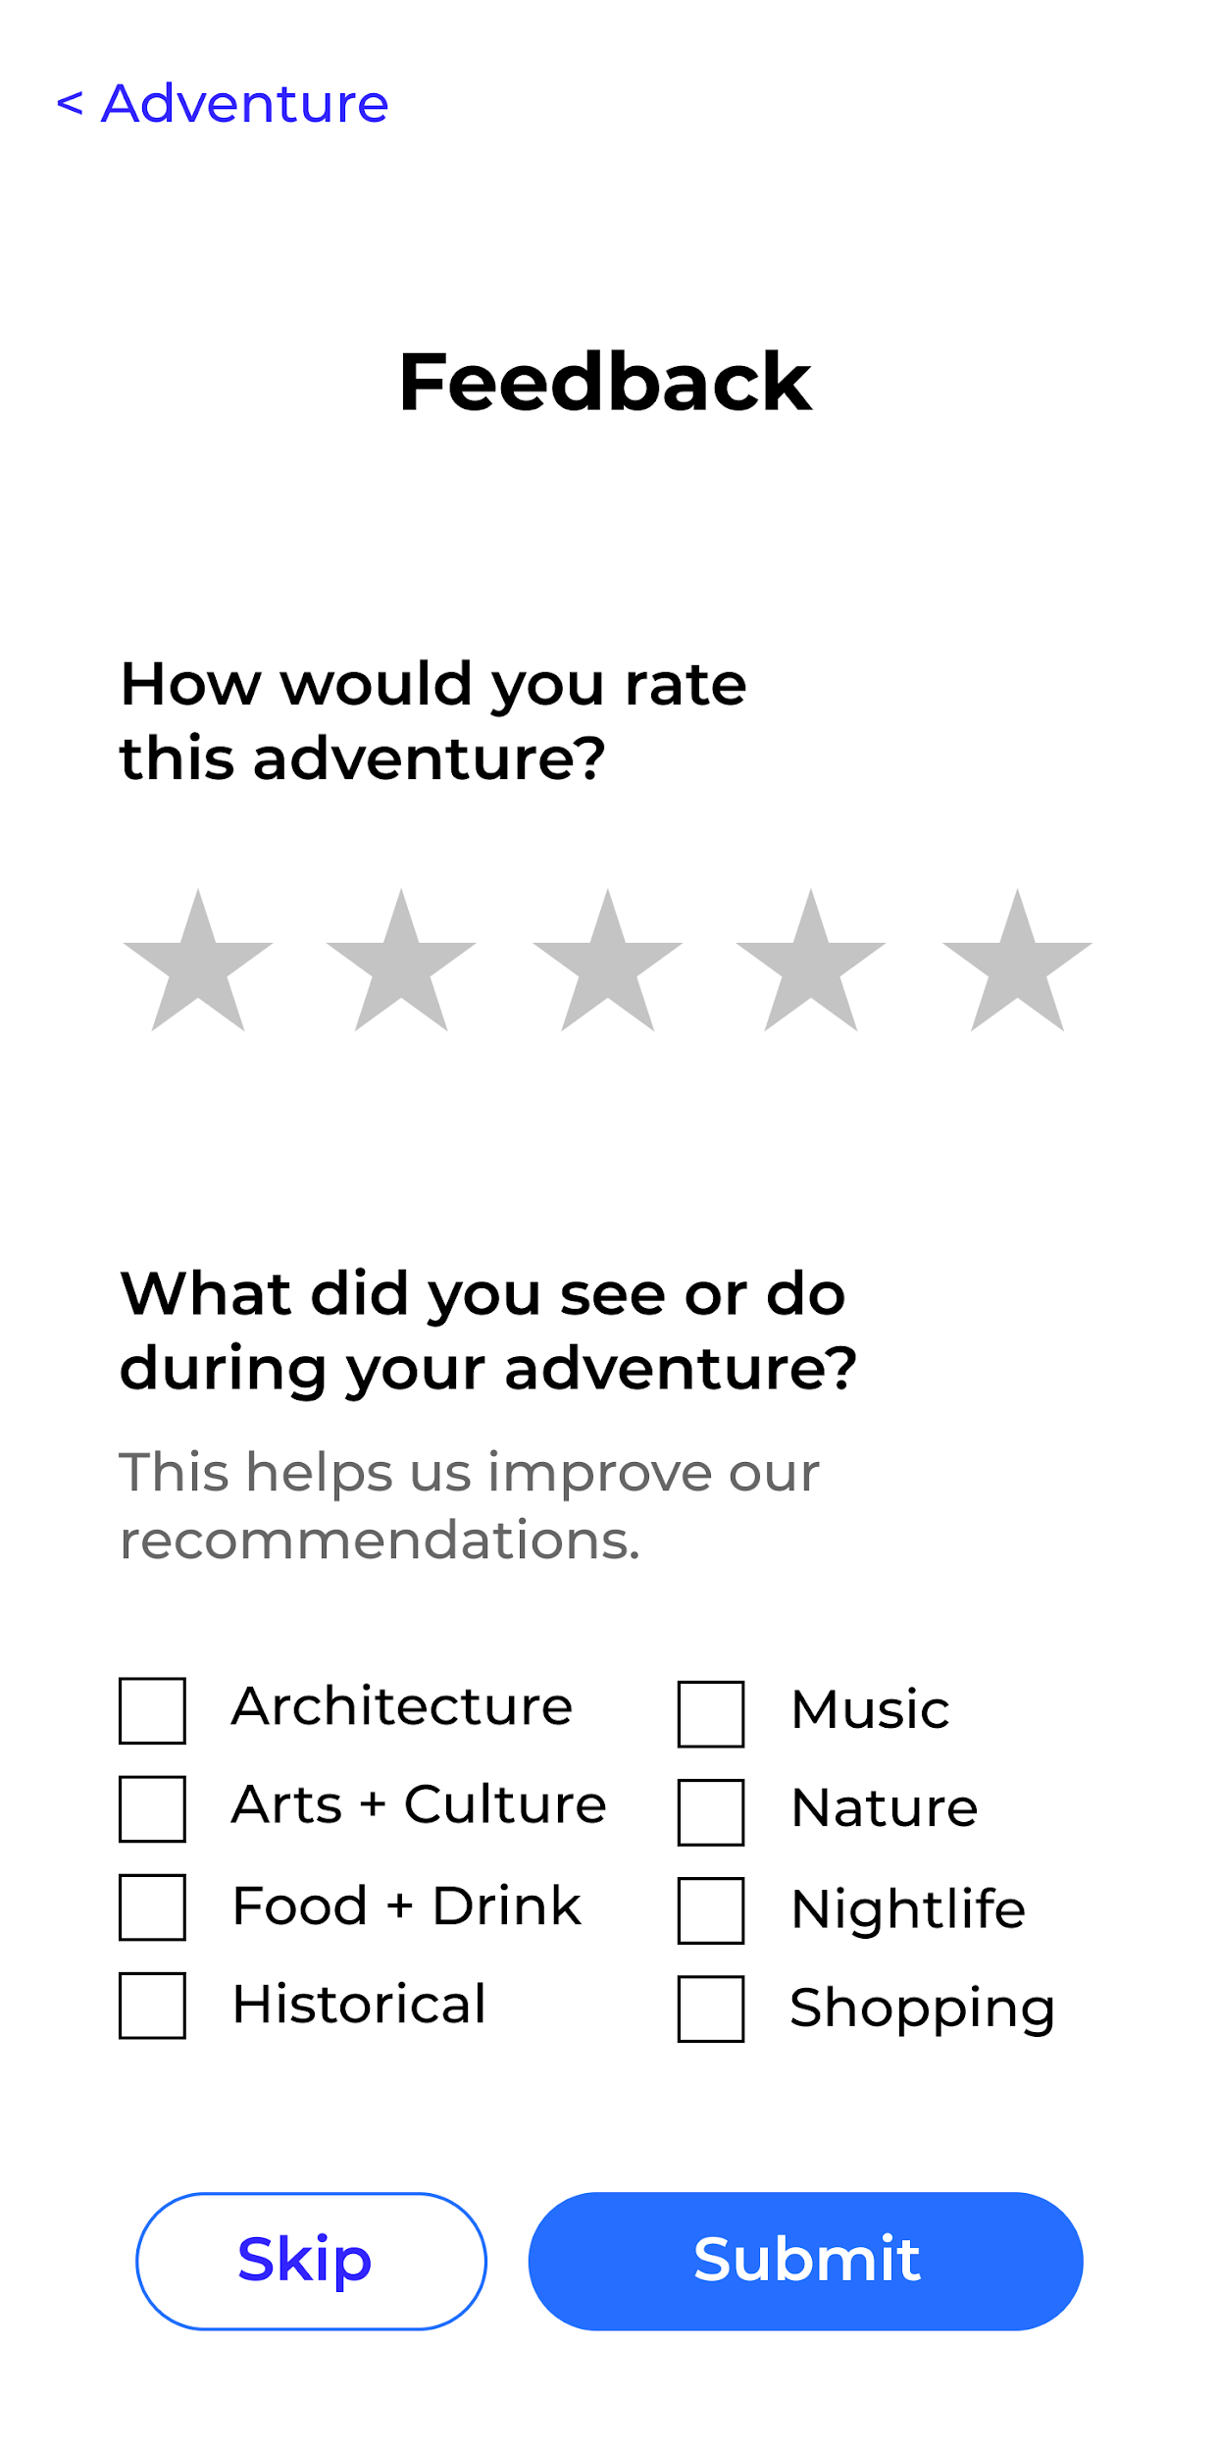
Hi-Fidelity Mockups: Adventure

Slide 16
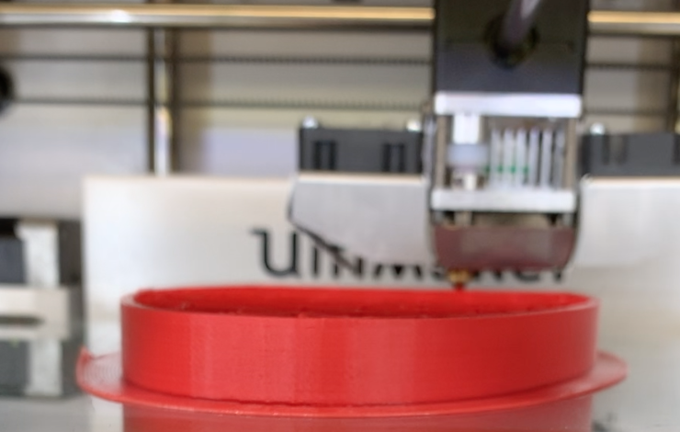
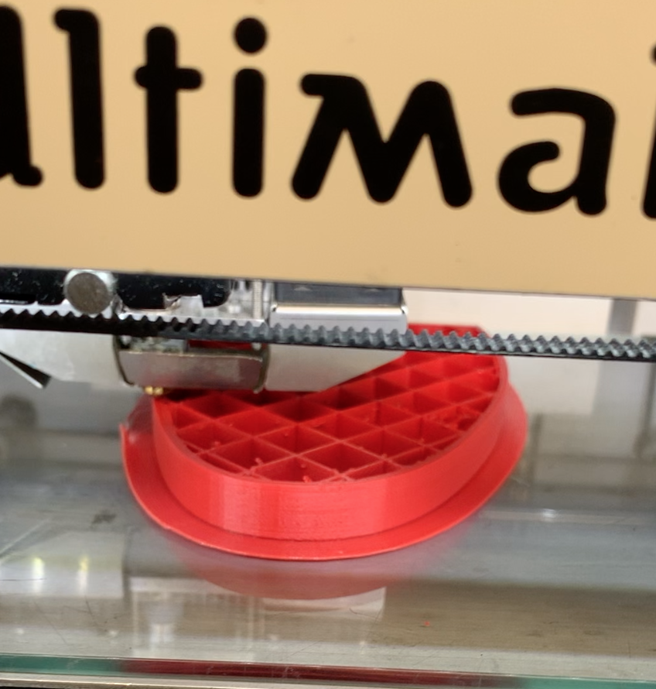
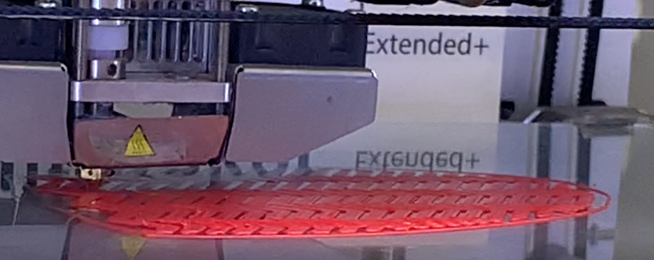
Our First Iteration: 3D-Print Shoes
Notes:
In future iterations, we wanted to make this an open source project.
Low risk way to prototype
Moved to higher fidelity because we wanted people to imagine what Derive could be as a finished product
Through the process of modeling & 3-D printing the sole, we got a better understanding of the structures we were working with.

Slide 17
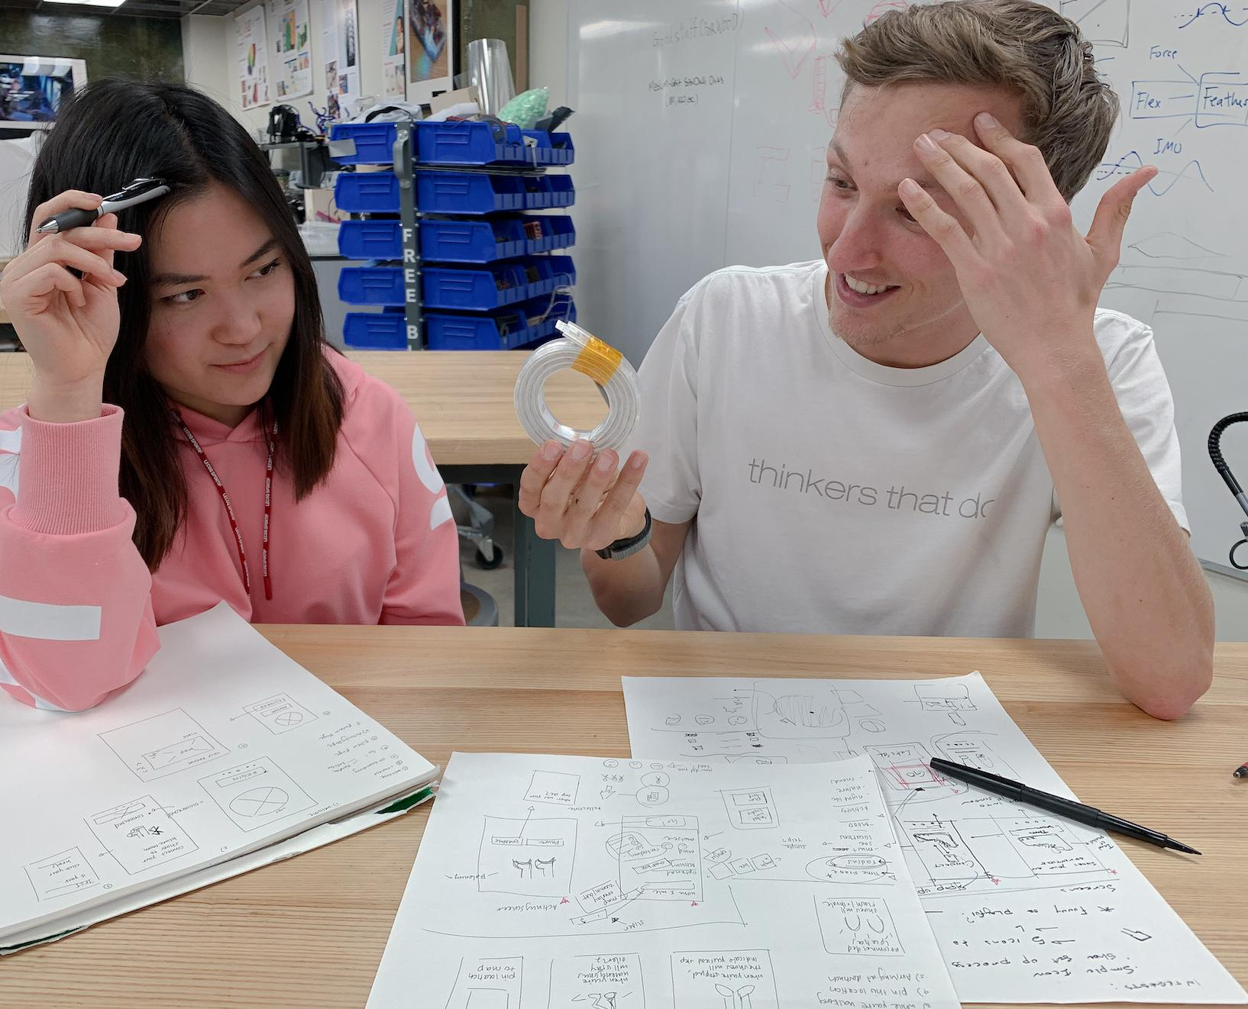
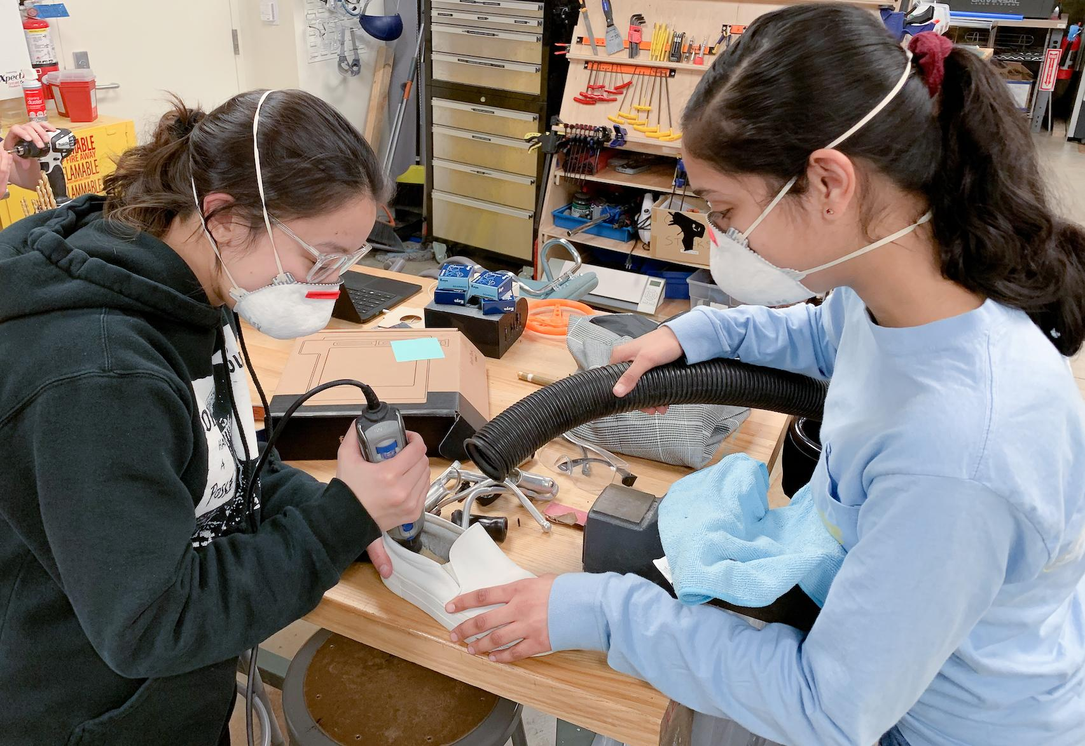
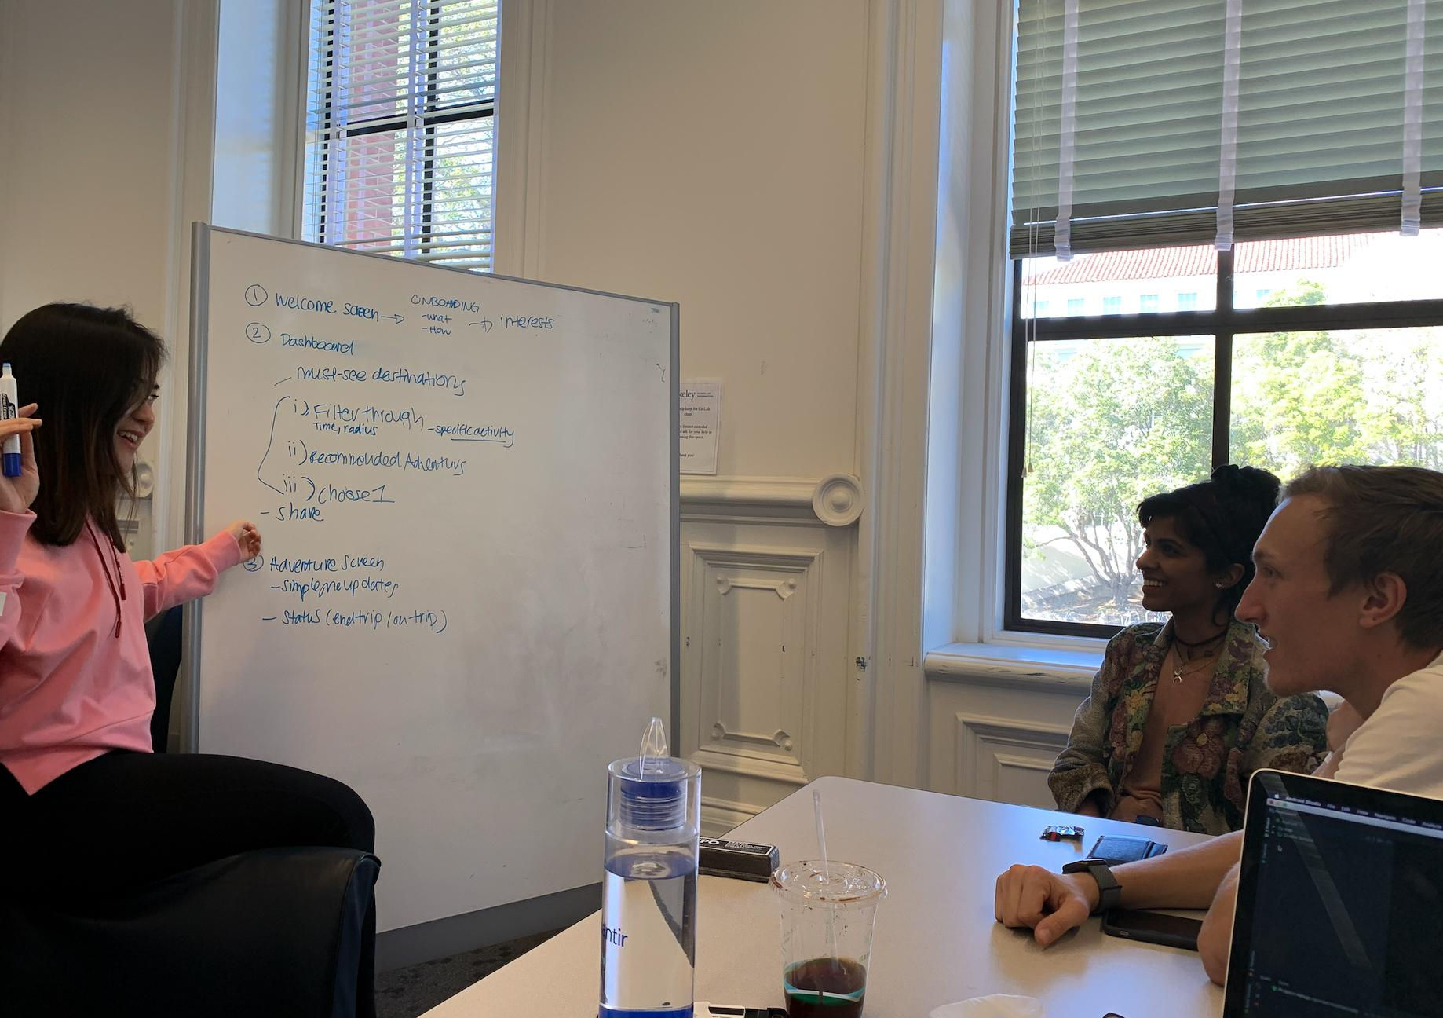
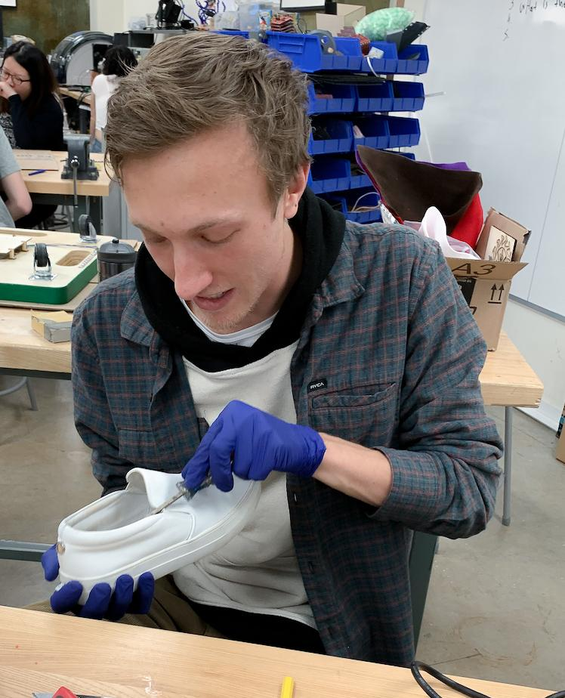
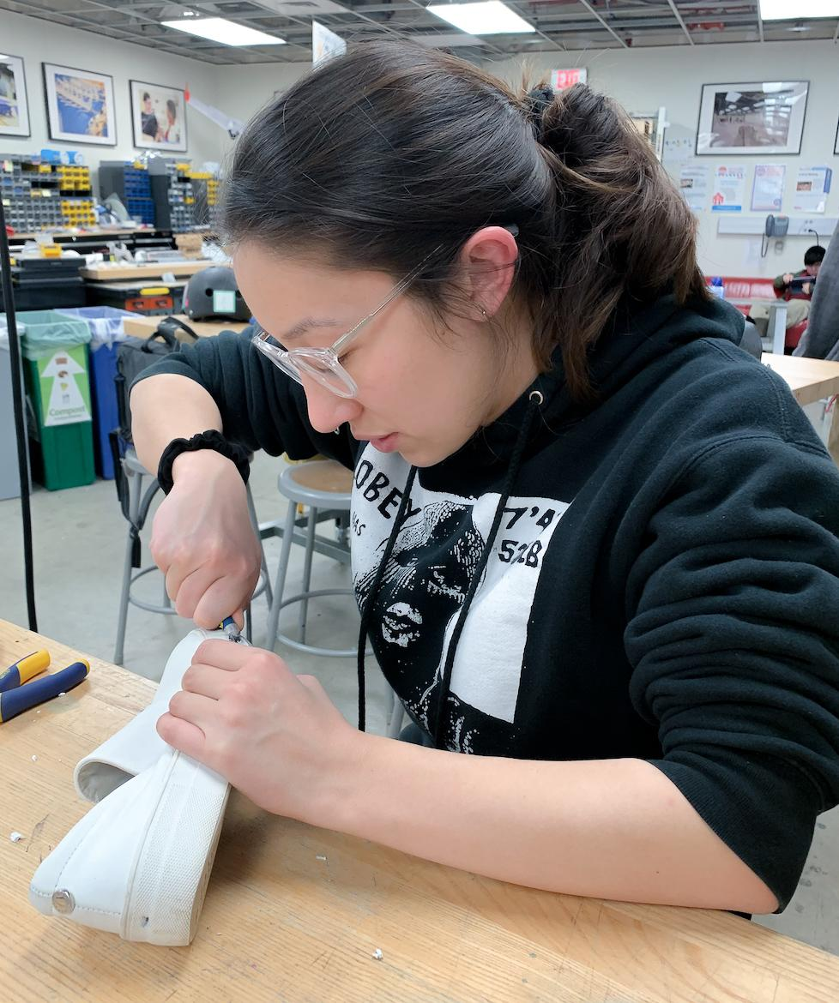
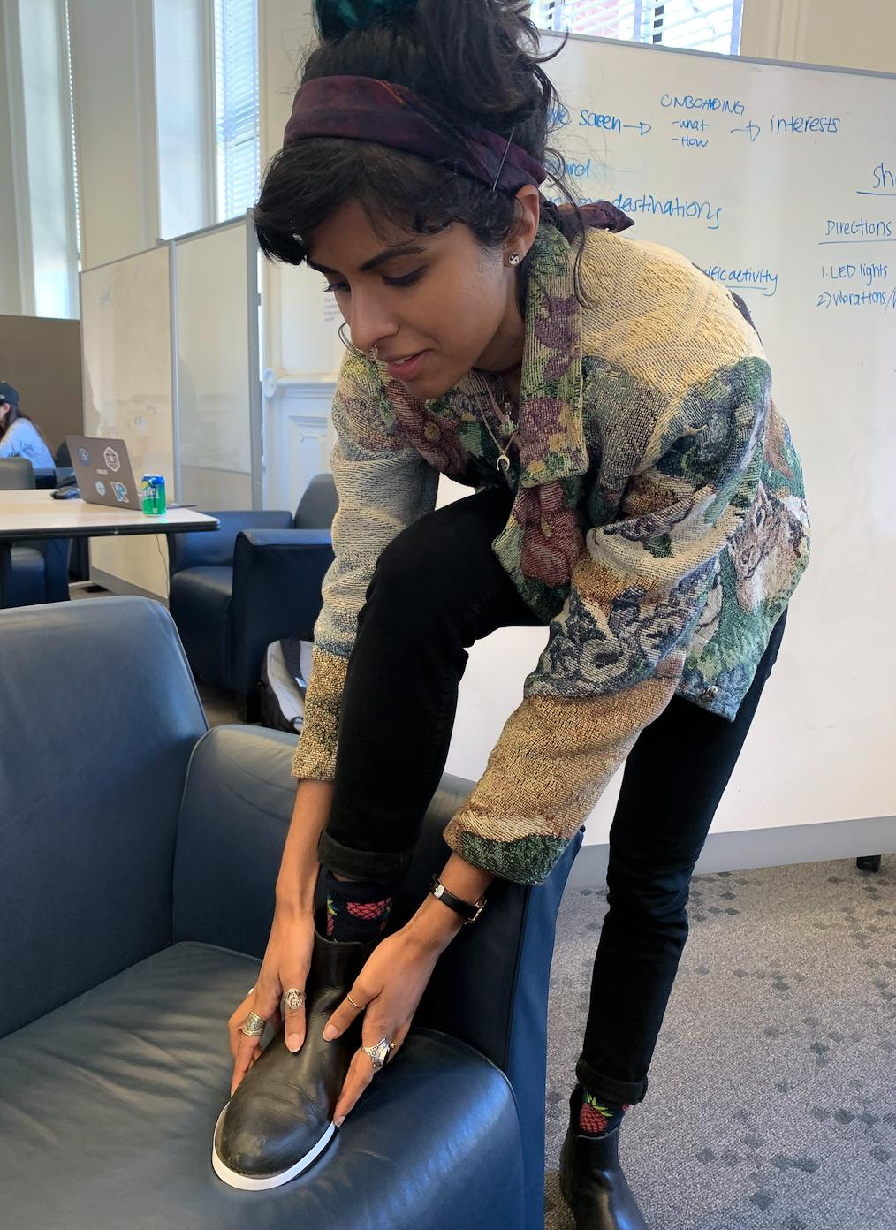
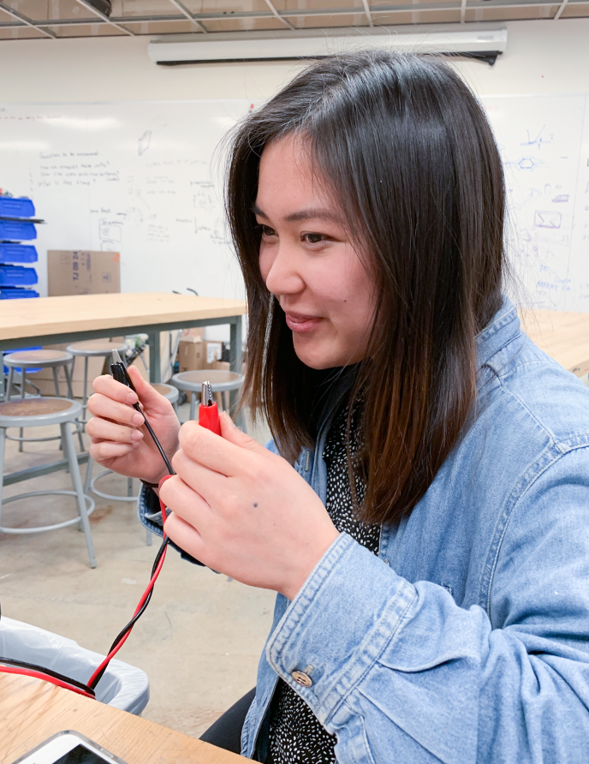
Notes:
We quickly started rapidly prototyping shoes, imagining

Slide 18
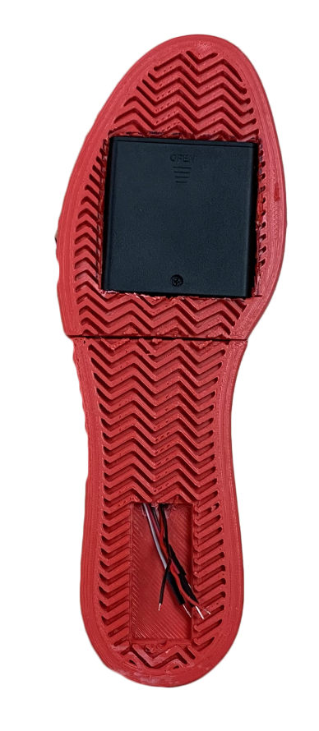
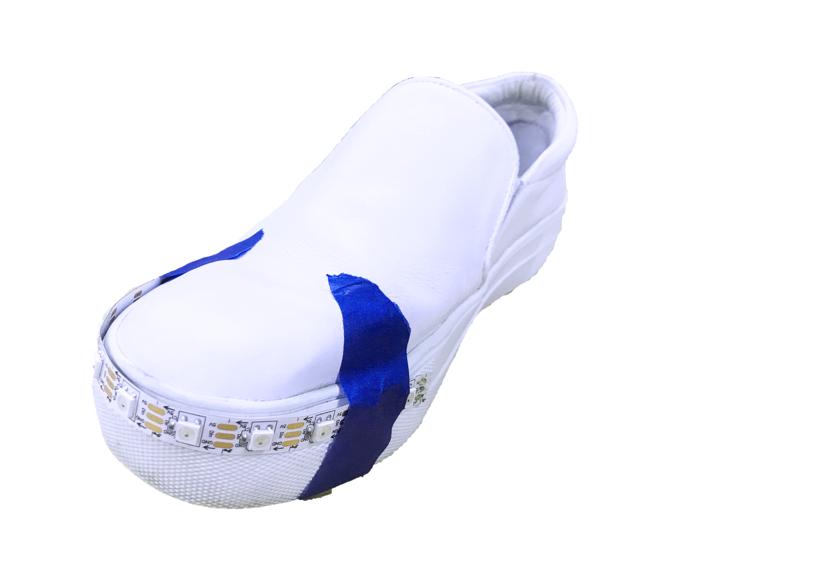
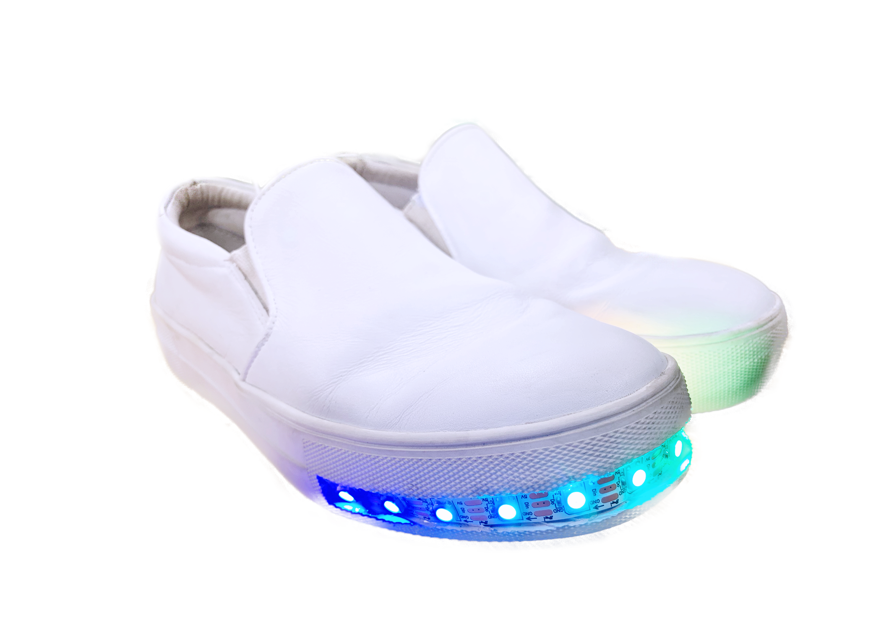
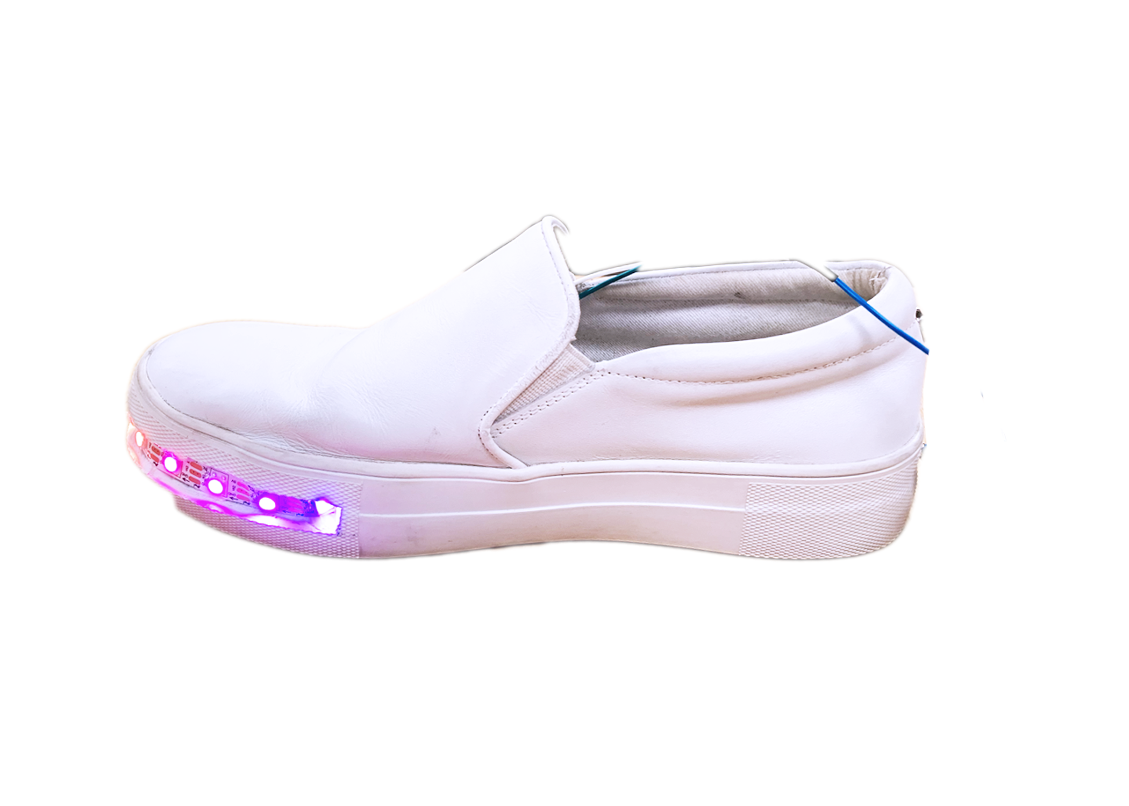
Work In-Progress ⟶ Product
Rapid Prototype
Frosted LEDS
3-D Print Prototype
Embedded LEDS

Slide 19
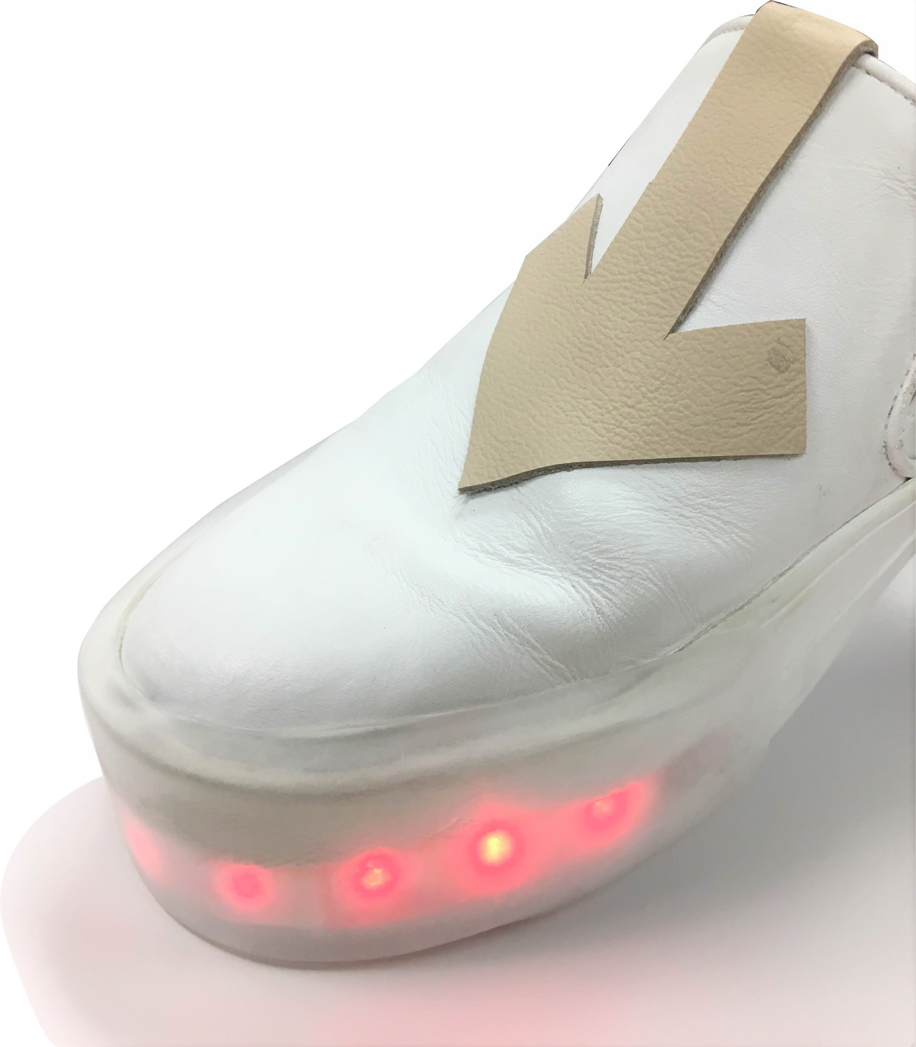
Final Form

Slide 20
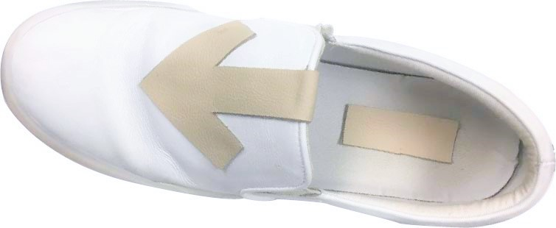
Fabrication & Technology
Feather M0 w/ Bluetooth
Leather Detailing
Neopixels that take you places
Thin 3.7V Lithium Battery
Power Switch & Charging Port

Slide 21
Future Considerations
Enable users to send status or location updates
Include haptic feedback to inform user of upcoming direction without distractions
Create modular lights to attach to different pairs of shoes
Record user journey to create a new adventure
Open Source: Accessible Android Platform, 3D Print Files

Slide 22
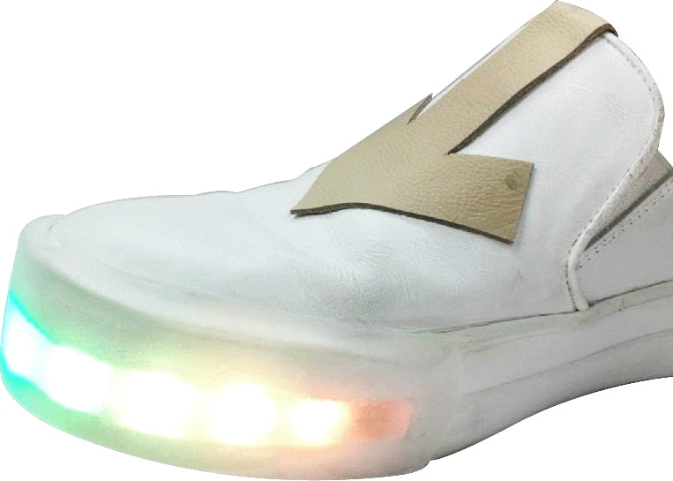
DÉRIVÉ
ARE YOU READY TO SHOES YOUR OWN ADVENTURE?

